Slide 1
Dialling the experience up to ten
Blue Labs

Slide 2




Agenda
ANALYSIS
RECOMMENDATIONS
IMPLEMENTATION
IMPACT

Slide 3
Executive Summary
CHALLENGE
Given current market trends, how can Blue Labs shape the retail experience of tomorrow?
KEY ISSUES
Creator Economy
Preference for Experience
Evolution of Shopping
STRATEGY
Walmart Virtual Creator: a Curated Marketplace from your favourite Creator
Walmart Virtual Creator: a Curated Marketplace from your favorite Creator
A curated shopping experience that’s driven by content creators around their expertise, where customers get customized shopping lists based on experiences and design ideas from their favorite creators
A curated shopping experience that’s driven by content creators around their expertise. Where customers get ideas for experiences and design ideas from their favourite in
IMPACT
+4.5M
Daily Interactions
+15%
Basket Size

Slide 4

Agenda
ANALYSIS
RECOMMENDATIONS
IMPLEMENTATION
IMPACT

Slide 5

Creators influence the purchasing decisions of customers in new ways
1
Creators need to monetise their influence in as many ways as possible
Creators
Creator
(coach to vlogger)
Content type (sports to tech)
Multiple platforms
(Tiktok to Youtube)
Multiple sizes
(1k -1m+)
Influence
Product & innovation
Marketing
Ideology & Entertainment
Collaboration
Nurturing
Community
Product & Fulfilment
Risk
Reputation
(Andrew Tate)
Customer ownership
How can we leverage the influence creators have over purchasing decisions?

Slide 6



A customers desire for experience requires an element of product purchasing
2
Products enhance the consumer need to maximise the quality of an experience
Enhance your hiking experience with hiking gear
Relive your food tour back home with the right groceries
Build strong bonds with family and friends while looking and feeling at your best
How can we create smooth connection between products and experience?

Slide 7
The evolution of shopping creates new ways to engage with customers
3
Easy content creation and sharing
Emergence of AI & AR
Social media and e-comm integration
Consumers needs are satisfied in a more personalised and faster ways
Wider variety of content
Advanced search algorithms
Interactivity & personalisation
How can we create more personalised and efficient ways to engage with consumers

Slide 8
Walmart has a lot to offer the creator economy
Resources - $3.5b investment
Strengths
Weakness
Brand and reach – offers a reach to 80% of Canada
Walmart’s infrastructure can increase creator reach
Size & Scale – offers a supply chain channel for creators
Walmart association with utility over emotion
…but its utility perception needs to be re-framed
Not fully leveraging influencers

Slide 9



Key Issues
1
Creator Economy
2
Preference for experience
3
Evolution of shopping
Requirement: leverage creator influence over purchasing decisions
Requirement: a smooth connection between products and experiences
Requirement: more personalised and efficient ways to engage with consumers

Slide 10

Agenda
ANALYSIS
RECOMMENDATIONS
IMPLEMENTATION
IMPACT

Slide 11




The options for Walmart to tackle the three key issues are…
Walmart Virtual Creator
Walmart Incubator
In-house Content Creation
Curated shopping experience driven by content creators
Influencer training program focusing on Walmart products
Setting up production capability for Walmart specific content
Overview
Creating an online platform in collaboration with influencers and customers
Using influencer videos to tailor consumer content
Boosting creator economy by providing specialized training
Offering the power of internal analytics to existing influencers
Develop in-house expertise to produce content
Use customer feedback to tailor content
Actions
Regenerative Ecosystem & Improved Engagement
Loyal Influencer Base & High Content Quality
Improved Customer Experience & Agility
Outcomes

Slide 12
Comparing Walmart’s options against the key concerns
Walmart Virtual Creator
Walmart Incubator
In-house Content Creation
Improving Customer NPS
1
2
3
4
5
1
2
3
4
5
1
2
3
4
5
Generating Alternative Rev Streams
1
2
3
4
5
1
2
3
4
5
1
2
3
4
5
Reducing Costs
1
2
3
4
5
1
2
3
4
5
1
2
3
4
5
Disruptive & Radical Innovation
1
2
3
4
5
1
2
3
4
5
1
2
3
4
5
Overall

Slide 13
Comparing Walmart’s options against the key concerns
Walmart Virtual Creator
Walmart Incubator
In-house Content Creation
Improving Customer NPS
1
2
3
4
5
1
2
3
4
5
1
2
3
4
5
Generating Alternative Rev Streams
1
2
3
4
5
1
2
3
4
5
1
2
3
4
5
Reducing Costs
1
2
3
4
5
1
2
3
4
5
1
2
3
4
5
Disruptive & Radical Innovation
1
2
3
4
5
1
2
3
4
5
1
2
3
4
5
Overall
18

Slide 14
Comparing Walmart’s options against the key concerns
Walmart Virtual Creator
Walmart Incubator
In-house Content Creation
Improving Customer NPS
1
2
3
4
5
1
2
3
4
5
1
2
3
4
5
Generating Alternative Rev Streams
1
2
3
4
5
1
2
3
4
5
1
2
3
4
5
Reducing Costs
1
2
3
4
5
1
2
3
4
5
1
2
3
4
5
Disruptive & Radical Innovation
1
2
3
4
5
1
2
3
4
5
1
2
3
4
5
Overall
18
13

Slide 15
Comparing Walmart’s options against the key concerns
Walmart Virtual Creator
Walmart Incubator
In-house Content Creation
Improving Customer NPS
1
2
3
4
5
1
2
3
4
5
1
2
3
4
5
Generating Alternative Rev Streams
1
2
3
4
5
1
2
3
4
5
1
2
3
4
5
Reducing Costs
1
2
3
4
5
1
2
3
4
5
1
2
3
4
5
Disruptive & Radical Innovation
1
2
3
4
5
1
2
3
4
5
1
2
3
4
5
Overall
18
13
11

Slide 16
The recommended strategy is…
Our recommendation
Walmart Virtual Creator
Walmart Incubator
In-house Content Creation
Improving Customer NPS
1
2
3
4
5
1
2
3
4
5
1
2
3
4
5
Generating Alternative Rev Streams
1
2
3
4
5
1
2
3
4
5
1
2
3
4
5
Reducing Costs
1
2
3
4
5
1
2
3
4
5
1
2
3
4
5
Disruptive & Radical Innovation
1
2
3
4
5
1
2
3
4
5
1
2
3
4
5
Overall
18
13
11

Slide 17




Walmart Virtual Creator is desirable because…
Customer
Influencer
Walmart
Skills
Market
Puts customers in the driver’s seat of their shopping experience
Provides an attractive platform for attracting a large customer base
Utilizes existing strengths of large customer base and international reach
Addresses key future requirements for Web 3.0 shopping
Provides adaptability in terms of tastes, affordability and utility
High probability of regenerative customer engagement
Our strategy targets the right
customer requirements
Our strategy is high on customer engagement
Our strategy leverages the business’ core strengths

Slide 18

Agenda
ANALYSIS
RECOMMENDATIONS
IMPLEMENTATION
IMPACT

Slide 19
Meet our influencer Anna @CozyMaple and our customer Ginny
INFLUENCER
CUSTOMER
Anna @CozyMaple
Ginny
Who
Canadian Interior Design Vlogger
31yo professional
Griffintown, Montreal
120,000 on YouTube
60,000 on Instagram
40,000 on Pinterest
Migrated to Canada 5 years ago,
works in bio-health
just got her own place
Desires
Wants to increase reach and generate more income
Follows 500 people on Instagram
Loves interior design

Slide 20
Meet our influencer Anna @CozyMaple and our customer Ginny
INFLUENCER
CUSTOMER
Anna @CozyMaple
Ginny
Who
Canadian Interior Design Vlogger
31yo professional
Griffintown, Montreal
120,000 on YouTube
60,000 on Instagram
40,000 on Pinterest
Migrated to Canada 5 years ago,
works in bio-health
just got her own place
Desires
Wants to increase reach and generate more income
Follows 500 people on Instagram
Loves interior design

Slide 21
Ginny’s four step process to replicate the theme
Ginny views CozyMaple video
Gets link to Walmart.ca virtual creator
customizes theme
selects and buys products from curated shopping list
1
2
3
4

Slide 22
Anna @CozyMaple’s income feedback loop
Walmart Website Visits to Influencer Site
Influencer directs to Walmart

Slide 23
Potential Themes for Walmart to focus on
Interiors
Experiences
Food

Slide 24
How will the team implement the new strategy?
Phase 1: Prototype and Create
Phase 2: Launch and Iterate
 | 2023 |  |  |  | 2024
 | Q1 | Q2 | Q3 | Q4 | Q1 | Q2 | Q3 | Q4
Mockup and Initial Feedback
Creator Engagement
Prototype Development
Launch

Slide 25

Agenda
ANALYSIS
RECOMMENDATIONS
IMPLEMENTATION
IMPACT

Slide 26
Risk management
# | Risk | Mitigation
1 | Inappropriate content | Start invite-only and EOI; vet creators on sign-up
2 | Substandard recommendations and curation UX | Design iteration, customer feedback, invest in technology
3 | Creator mismatch with Walmart | Hand-pick at first to ensure good content-product match
4 | Authenticity lost | Ensure that creators have enough themes to customise
1
2
3
Probability
Low High
4
Low High
Impact

Slide 27
Cost breakdown
Task | Cost Estimate
Mockup & initial feedback | $20,000
Develop functional prototype | $250,000
Initial creator engagement | $5,000-$20,000
Total | $275,000-$290,000

Slide 28
Opportunity sizing
~3M
daily customer interactions
Urban customers underserved
+4.5M = 7.5M
daily customer interactions
Boost engagement with urban customers
+15%
Average Basket Size
Basket size increase
Category | Additional $ | Estimated % increase
Home | $50 | $15
Hiking/Outdoors | $30 | $20
Grocery | $25 | 10%

Slide 29
Executive Summary
CHALLENGE
Given current market trends, how can Blue Labs shape the retail experience of tomorrow?
STRATEGY
Walmart Virtual Creator: a Curated Marketplace from your favourite Creator
Walmart Virtual Creator: a Curated Marketplace from your favorite Creator
A curated shopping experience that’s driven by content creators around their expertise, where customers get customized shopping lists based on experiences and design ideas from their favorite creators
A curated shopping experience that’s driven by content creators around their expertise. Where customers get ideas for experiences and design ideas from their favourite in
KEY ISSUES
Creator Economy
Preference for Experience
Evolution of Shopping
IMPACT
+4.5M
Daily Interactions
+15%
Basket Size

Slide 30
Appendix: List of other ideas
Creator incubator
  Stamp/certification
  Authenticity and training
Walmart content creation
  Entertainment and content
Product analytics
  To support blogging
Design outsourcing to creators
  Virtual creator
Virtual background for creators
  Curated recommendation
  Creator Experience in store
A way to speed up content creation / automation
Reviews you get points
  Content and products
  Internal employee content creation

Slide 31
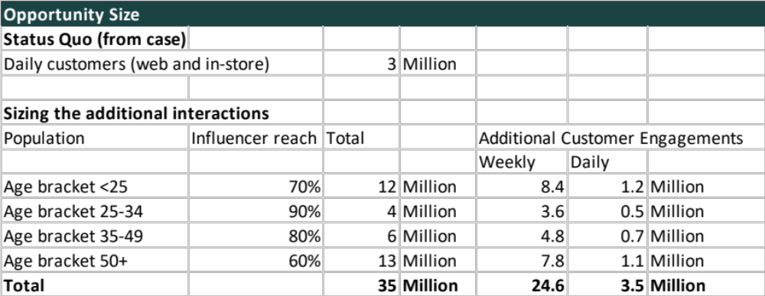
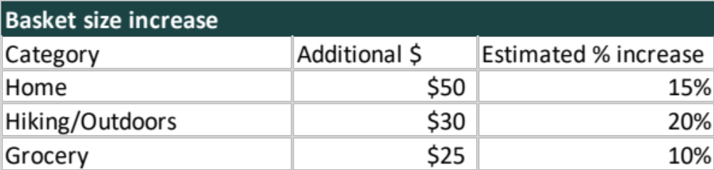
Appendix: Financials

