Slide 1

Blue Labs: Shaping the Retail Experience through
Canada
Presenting to: Blue Labs
Presented by: Ariel Gardner, Jechayni Khobalakrishnan,
Sean Visser, and Tyler Boulanger
Date: January 1st, 2023
Notes:
Sean’s TODO List
Fix up decision matrix, graphs, Power BI
Improve decision matrix box
Align
Group and ungroup shit
Make more detailed Excel shit

Slide 2
There is an opportunity for Blue Labs to lead disruptive and radical innovation in retail by leveraging the power of Walmart Canada and through the engagement of the creator economy.
Notes:
A complete home shopping experience

Slide 3
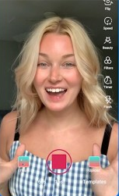
Meet Milly

Slide 4
Meet Milly
31 years old

Slide 5
Meet Milly
31 years old
Loves interior designing!

Slide 6
Meet Milly
31 years old
Loves interior designing!
Content creator

Slide 7
Meet Milly
31 years old
Loves interior designing!
Content creator
Currently has an average of 500K followers throughout Instagram, Pinterest, and TikTok

Slide 8
Meet Milly
31 years old
Loves interior designing!
Content creator
Currently has an average of 500K followers throughout Instagram, Pinterest, and TikTok
1.4% engagement and a mid-size creator

Slide 9
Meet Milly
31 years old
Loves interior designing!
Content creator
Currently has an average of 500K followers throughout Instagram, Pinterest, and TikTok
People love her and value her opinions on house decor
1.4% engagement and a mid-size creator

Slide 10
Milly’s Needs

Slide 11
Milly’s Needs

Slide 12
Milly’s Needs
❌ Higher engagement on platforms

Slide 13
Milly’s Needs
❌ Higher engagement on platforms
❌ Has ideas for products but does not have knowledge of design, manufacturing, or business in general

Slide 14
Milly’s Needs
❌ Higher engagement on platforms
❌ Has ideas for products but does not have knowledge of design, manufacturing, or business in general
❌ More pay

Slide 15
Milly’s Needs
❌ Higher engagement on platforms
❌ Has ideas for products but does not have knowledge of design, manufacturing, or business in general
❌ More pay

Slide 16
Preferred Solution
The Blue Spot Home Showcases
Experiential overstay opportunities for end consumers promoted by Content Creators
Notes:
Experiential home showcase shopping experience promoted by content creators

Slide 17
Preferred Solution
The Blue Spot Home Showcases
Experiential overstay opportunities for end consumers promoted by Content Creators
BLUE PLAN
Notes:
Experiential home showcase shopping experience promoted by content creators

Slide 18
Key Issues

Slide 19

Key Issues
 | - Importance +
- Urgency +
Change in Consumer Behaviour

Slide 20

Key Issues
 | - Importance +
- Urgency +
Change in Consumer Behaviour
Competition

Slide 21

Key Issues
 | - Importance +
- Urgency +
Change in Consumer Behaviour
Competition
Integration with Creators

Slide 22
Analysis

Slide 23

What are Walmart’s Key Capabilities?
Identify
Global Scale
Canada
Efficient, established supply chain processes
Large amount of physical stores
In-house software development expertise
Wide variety of product departments
Existing collaborations with content creators through products and marketing
Experience supporting creator growth with Walmart Creator

Slide 24
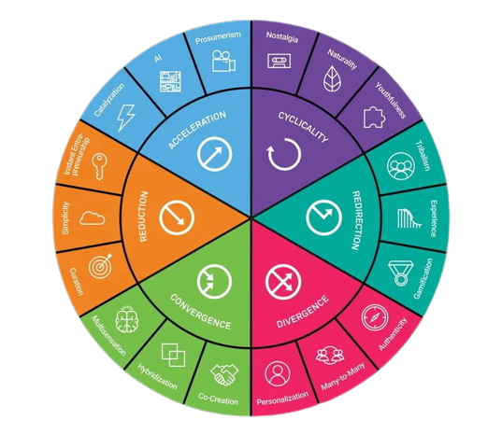
What are Walmart’s Key Capabilities?
Identify
Global Scale
Efficient, established supply chain processes
Large amount of physical stores
In-house software development expertise
Wide variety of product departments
Existing collaborations with content creators through products and marketing
Experience supporting creator growth with
Walmart Creator

Slide 25

Where is Walmart Trailing Others?
Identify
Personalized Digital Storefronts
Integration with content platforms
Development or co-creation of products for other brands
Content creation platforms
Creator management & support
Experiential shopping
Lower product quality reputation
Less product loyalty & tribalism
Canada

Slide 26
Where is Walmart Trailing Others?
Identify
Personalized Digital Storefronts
Integration with content platforms
Development or co-creation of products
for other brands
Content creation platforms
Creator management & support
Experiential shopping
Lower product quality reputation
Less product loyalty & tribalism

Slide 27
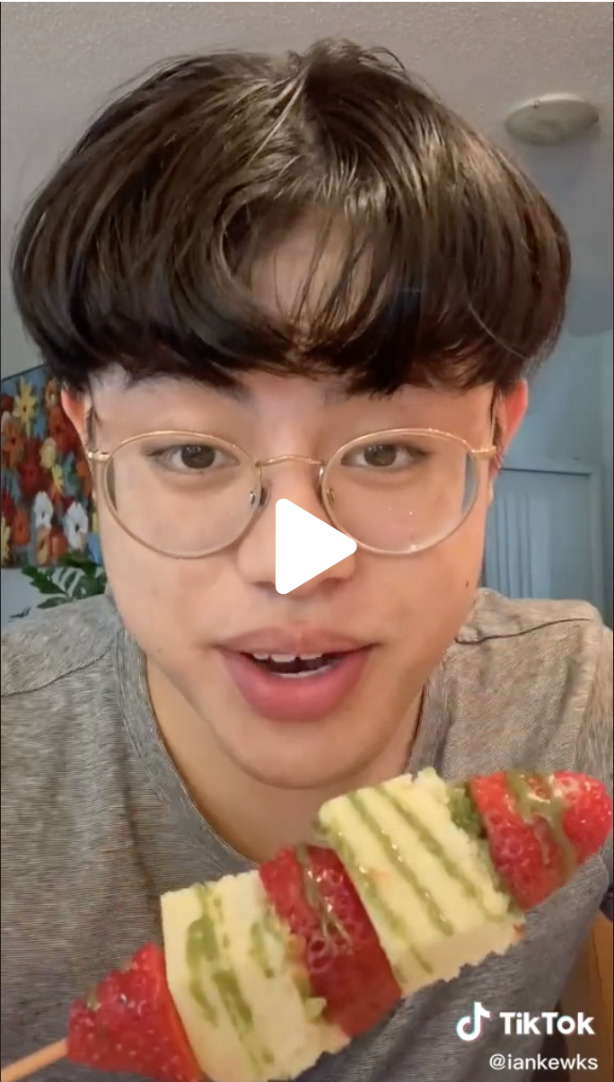
How Are Creators Feeling?
Empathize

Slide 28

How Are Creators Feeling?
Empathize
PAINS
Difficult to grow audience
Lack of customer retention
Unreliable product partners
Lack of business expertise
Revenue & audience diversification
Difficult finding trustworthy partners

Slide 29

How Are Creators Feeling?
Empathize
PAINS
DESIRES
Difficult to grow audience
Lack of customer retention
Unreliable product partners
Lack of business expertise
Revenue & audience diversification
Difficult finding trustworthy partners
Larger, sustained audience
Stronger audience engagement
Affordable content for audience
Easier for audience to reach their products
Support in content development
Stable, consistent partners

Slide 30

How Are Shoppers Feeling?
Empathize

Slide 31
How Are Shoppers Feeling?
Empathize
PAINS
Financially stretched
Time-stretched
Less desire for physical products
Geographic distance from creators
Impatient with product shipping

Slide 32
How Are Shoppers Feeling?
Empathize
PAINS
DESIRES
Affordable products
Experience-based purchases
Ease of accessing products
Authentic connection with their favourite creators
Consistent product quality
Financially stretched
Time-stretched
Less desire for physical products
Geographic distance from creators
Impatient with product shipping

Slide 33

What does Walmart need to do?
Define
KEY PROBLEM TO SOLVE
How can affordable, quality products be provided to customers?
How exciting experiences be incorporated into their shopping experience?
How can creators ensure they have a consistent revenue source?

Slide 34
Opportunities

Slide 35



Opportunities
Integrated
Community Shops
Blue Spot
Home Showcases
Branded Product Packages
Notes:
Fix colours

Slide 36
Opportunities
Integrated
Community Shops
Notes:
Fix colours

Slide 37

Opportunities
Integrated
Community Shops
Blue Spot
Home Showcases
Notes:
Fix colours

Slide 38
Opportunities
Integrated
Community Shops
Blue Spot
Home Showcases
Branded Product Packages
Notes:
Fix colours

Slide 39


Integrated Community Shops
1
Offering e-commerce-as-a-service to large community engagement platforms like Discord, Reddit, or YouTube.
Creators would be able to build a store directly in their community on the website for branded products to be sold while leveraging Walmart’s infrastructure.
Benefits
Able to integrate purchasing into creator content/communities
Able to drive large amount of sales through platform
Considerations
Several other competitors with stores built into content
Relies on partner cooperation
Creators require some business know-how
Notes:
Fix colours

Slide 40
Blue Spot Home Showcases
2
Aesthetically unique condos with rotating exciting themes that entice sales for a specific department or product line.
Creators can create content with their merchandise and help design the condo, while receiving commission from affiliate links on products.
Benefits
Provide an engaging experience the public will seek out
Creators can develop content and make more income
Markets products in a novel light
Considerations
High capital costs required
Relies on influencer content for effectiveness
Notes:
Fix colours

Slide 41
Branded Product Packages
3
Creators build packages of Walmart products, including some with their brand, that correspond with their content.
This includes groceries for cooking creators, sports equipment for athletes, or books for educators.
These products could be collected in Walmart locations through scanning them in an app, which plays content for each item scanned.
Benefits
Encourage the purchase of multiple products
Able to reach a wide range of audience
Provide a unique in-store experience
Considerations
Creators can assemble product packages on their own
Other stores offer product bundles
Safety issue to have shoppers staring at their phone
Notes:
Fix colours

Slide 42
Decision Matrix
Decision Criteria
Follows Consumer Trends
Competitive Advantage
Creator Integration
Total
1
5
Low
High

Slide 43



Decision Matrix
Decision Criteria | Weight | Content Condos | Community Shops | Product Packages
Follows Consumer Trends | 0.4 | 5 | 4 | 3
Competitive Advantage | 0.3 | 4 | 3 | 2
Creator Integration | 0.3 | 4 | 3 | 4
Total | 1 | 4.4 | 3.4 | 3
1
5
Low
High

Slide 44

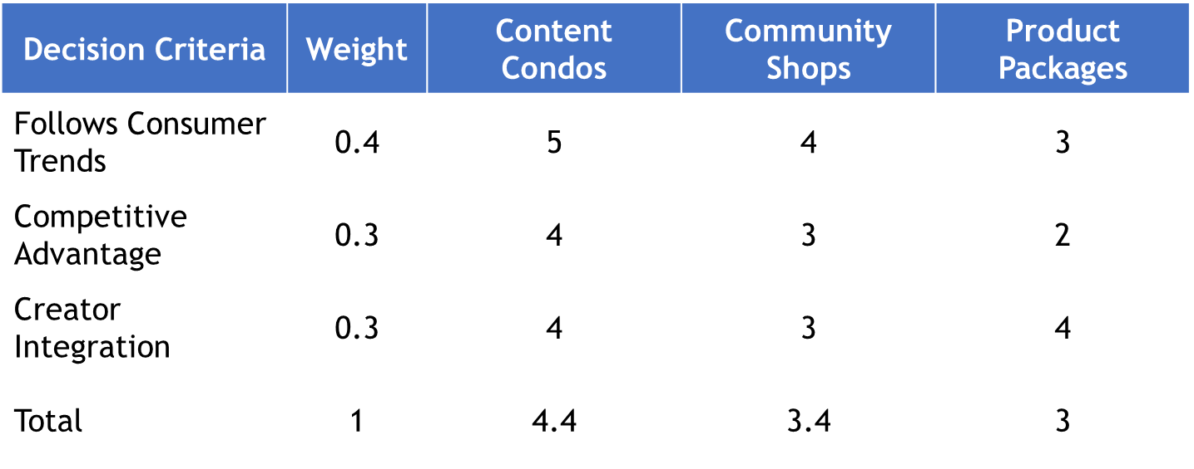

Decision Matrix
1
5
Low
High

Slide 45
Preferred Solution

Slide 46
Preferred Solution
The Blue Spot Home Showcases
Direct to manufacturer and product innovation support to Mid and Macro Content Creators
Content production facility for Creators called the “Blue Spot”
Experiential shopping opportunities for end consumers with over night stays at a Blue Spot location

Slide 47
Preferred Solution
The Blue Spot Accelerated Program
Direct to manufacturer and product innovation support to Mid and Macro Content Creators
Content production facility for Creators called the “Blue Spot”
Experiential shopping opportunities for end consumers with over night stays at a Blue Spot location
Notes:
Home hs

Slide 48
Implementation
Notes:
Joy
Fun
Aim
Fit
New
Own
Big
Ace
Fly
Grow
Kind
Feeed
Eat
Heal
Care
Best
Brew
Cure
Fast
Flow
Gain
Hold
Home
Hook
Jump
Life
Live
Look
News
Peak
Rise
Star
Sway
View

Slide 49
Implementation
Jan 2023
B
uild
1 year
L
aunch
Jan 2024
U
1 year
pdate
Jan 2025
E
1 Year
Valuate Performance
Jan 2026

Slide 50
Content Creator Experience Walkthrough
Content Creators
The Blue Spot Accelerator Program
Walmart Product Innovation Hub
Post and share content on social media platforms
Create Content in a Content Condo (Blue Spot Condo) showcasing products sold at Walmart or own products
Walmart Fulfilment Center (End to End Distribution and fulfillment services)

Slide 51
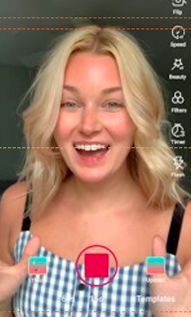


Audience Experience Walkthrough - Online
Tiktok
Walmart.ca/Milly
Product Links
Add to Cart
Milly Brown Couch
Product description
View content produced by Milly
Click on affiliate links to view featured products
Purchase products on Walmart website

Slide 52

Audience Experience Walkthrough – In Person
Tiktok
Walmart.ca/MillyExperience
Schedule a stay at the Content Condo
Book
Content Condo
Condo description
View content produced by Milly
Click link to book a stay at the content condo that features products displayed by Milly
Book a stay at a Blue Spot

Slide 53



Audience Experience Walkthrough – In Person
Walmart.ca
Milly Brown Couch
$800 CAD
Product Description
Ship to Home
Milly Brown Couch
Scan products QR code within the Blue Spot
Purchase product by selecting “Ship to Home”
Experience the products in person at a Blue Spot Condo

Slide 54

Revenue Generating Opportunities
Creators / Influencers
Product Sales
Affiliate Links
Content Production
Sale of products designed by Creators purchased by viewers online or when staying in Content Condo
Creators earn 5% of every sale achieved through affiliate links shared on social media platforms
Creators paid by Walmart to product content and shared on social media platforms

Slide 55
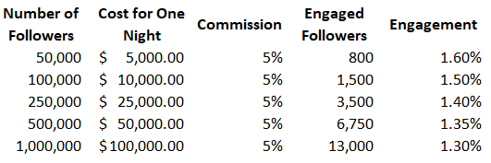
Content Production Payment Tiers

Slide 56
Strategyzer Innovation Timeline
High number of ideas
High investment
Product Design
Onboarding
Prototyping
Validating
Low investment
Low number of concepts

Slide 57
Build
Blue
Duration: Jan 2023 - 2024
2023
2024
2025
2026
2027
Key Actions
Objectives
Create first prototype Toronto location
Secure influencers for first week of Toronto location
Perfect QR code software
Gather evidence
Develop partnership with Walmart Canada for supply chain and delivery use
Location
  Purchase first Toronto condo
  Renovate location
    Walmart products
    Content creation tools
Content creation
  Develop Blue Spot Accelerator Program
  Contact specific content creators to collaborate and stay
  Create content creator products from white labels
Owners
Blue Labs
  Research + Development Specialist
  Design Thinking Specialist
Costs
Total
$6M
Toronto Condo
  $5,000,000
IT
  $1,000,000

Slide 58
Launch
bLue
Duration: 2024 - 2025
2023
2024
2025
2026
2027
Key Actions
Objectives
Launch first Blue Spot to content creators and public
Soft launch multiple new Blue Spots
Open prototype Blue Spot to content creators for one night stays for one week
Release content and open Blue Spot to public to rent for one night stays
Evaluate key data points:
  Engagement rate
  Net Promoter Score
  Waitlist
Continue to secondary locations
  Montreal
  Vancouver
  Halifax
Owners
Blue Labs
  Prototype Engineer + Developer
  Innovation Analyst
Costs
Total
$27M
Content Creators
  $1M
Locations
  $20M

Slide 59
Update
blUe
Duration: 2025 - 2026
2023
2024
2025
2026
2027
Key Actions
Objectives
Integrate program fully into Walmart Canada
Graduate project to newly created Blue Spot Management
Purchase and renovate new locations
Evaluate effectiveness of individual locations and products
Iteratively integrate new products, branded and white label
Graduate program to Walmart Canada created management team
  Blue Spot Management
Expand across Canada and internationally
Owners
Blue Labs
Blue Spot Management
Costs
Total
$27M+
Locations
Managment

Slide 60
Evaluate
bluE
Duration: 2026+
2023
2024
2025
2026
2027
Factor | Target | Deadline
Audience Engagement | 1.8% | Ongoing
Growth of Content Creators | 15% annual growth | Ongoing
Customer NPS | 80% | End of 2025
Number of Affiliate Link Sales | 15,000 | End of 2025

Slide 61
Risks

Slide 62
Risks
Risk | Likelihood | Impact | Contingency
Low customer interest | M | L | Encourage creators to promote the homes on their social media platforms prior to sale
Public perception | M | M | Increase thematic opportunities to allow for more personal interests to
Low content creator interest | H | H | Incentivize creators through high percentage of monetary benefit on affiliate links

Slide 63
Recalling Milly’s Needs
✅ Higher engagement on platforms

Slide 64
Recalling Milly’s Needs
✅ Higher engagement on platforms
✅ Has ideas for products but does not have knowledge of design, manufacturing, or business in general

Slide 65
Recalling Milly’s Needs
✅ Higher engagement on platforms
✅ Has ideas for products but does not have knowledge of design, manufacturing, or business in general
✅ More pay

Slide 66
Recalling Milly’s Needs
✅ Higher engagement on platforms
✅ Has ideas for products but does not have knowledge of design, manufacturing, or business in general
✅ More pay

Slide 67
Preferred Solution
The Blue Spot Home Showcases
Experiential overstay opportunities for end consumers promoted by Content Creators
BLUE PLAN
Notes:
Experiential home showcase shopping experience promoted by content creators

Slide 68
Appendix

Slide 69
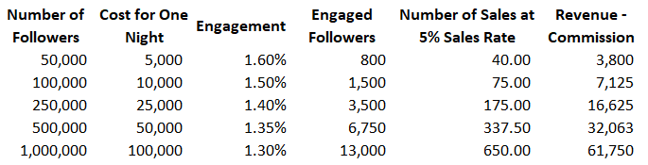
Content Creator Costs

