Slide 1
GlaxoSmithKline
THE FUTURE OF EMMA WALMSLEY
JOHN MOLSON MBA INTERNATIONAL CASE COMPETITION – CASE 5
2023

Slide 2
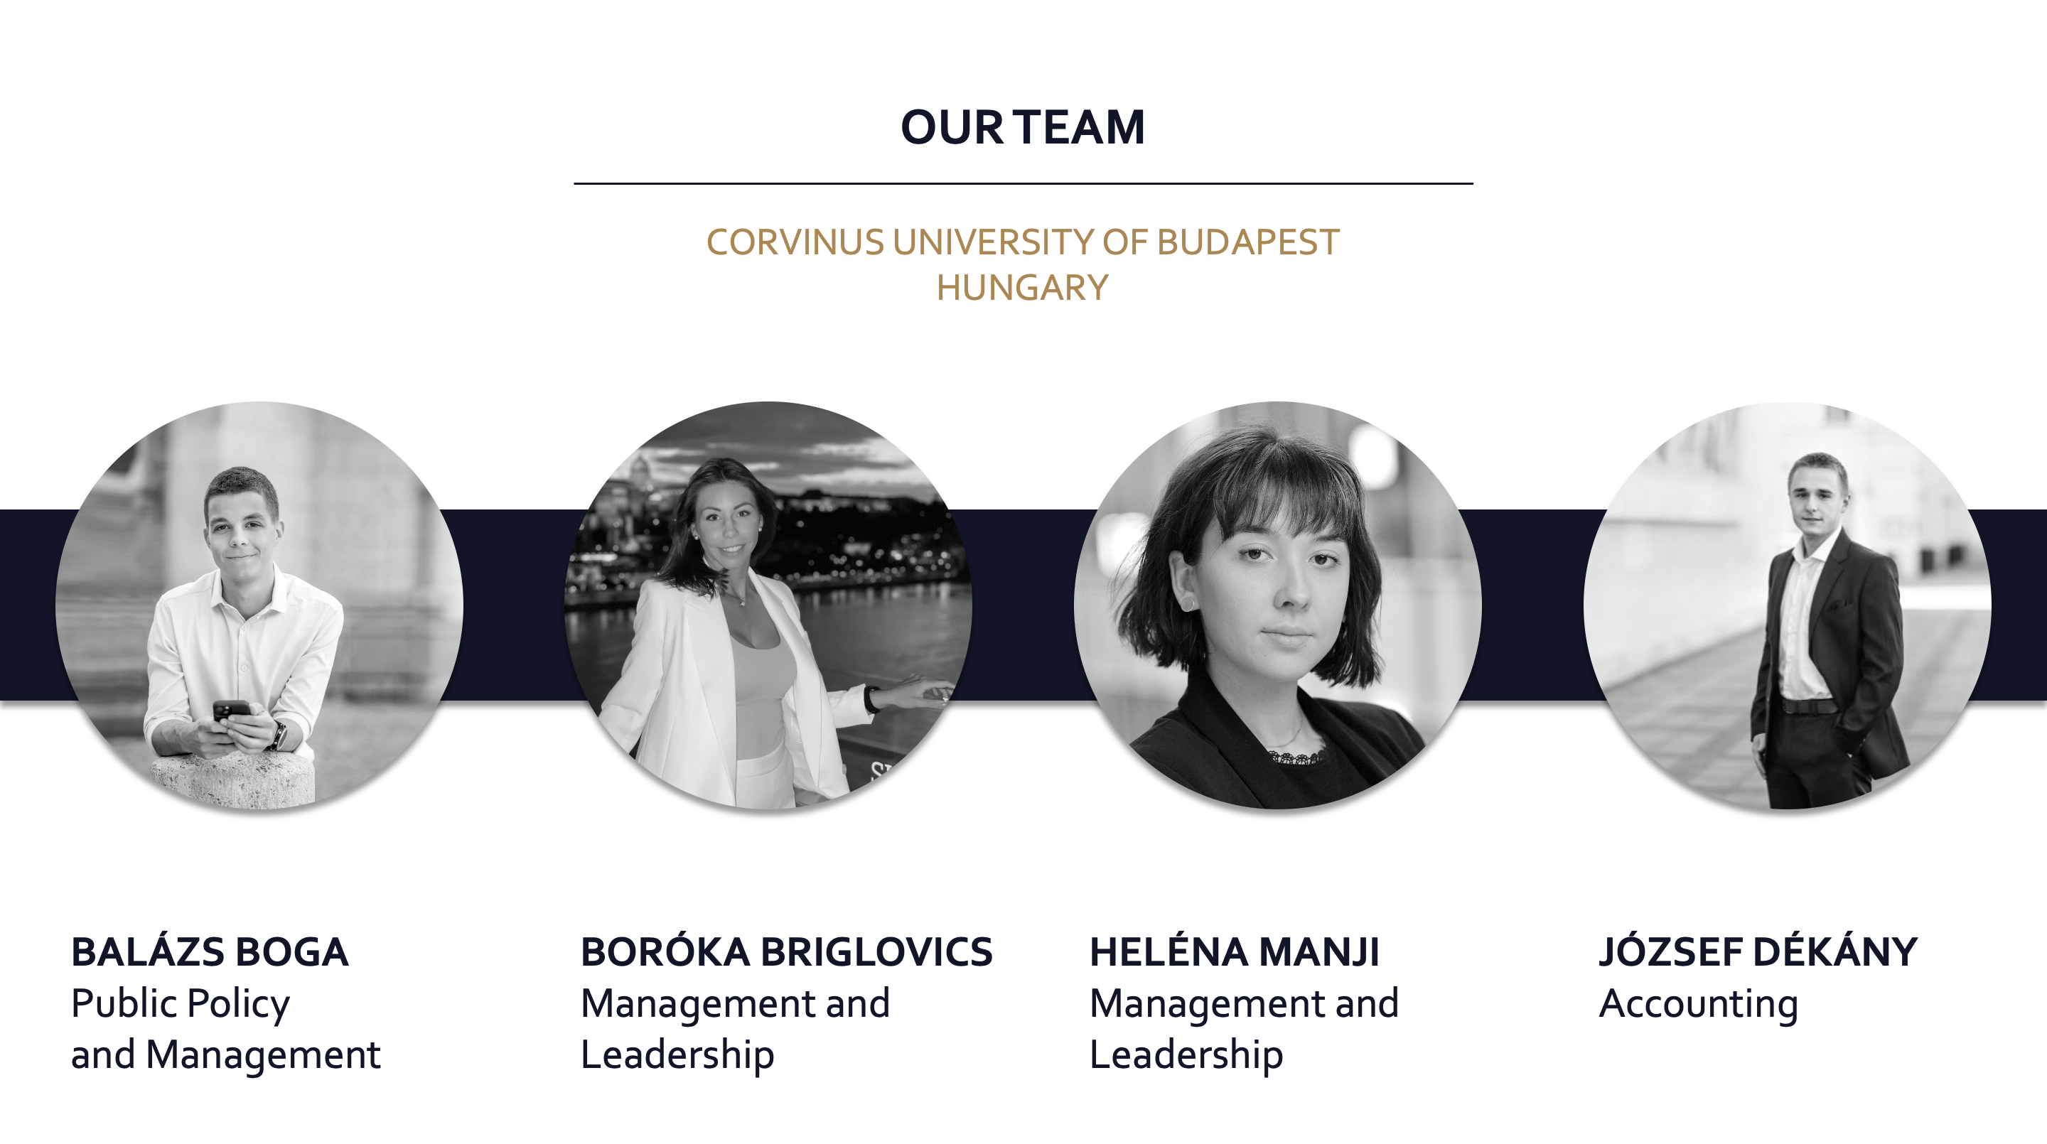

Slide 3
EXECUTIVE SUMMARY
Executive summary with the most important elements of the solution.
ANALYSIS
NEED TO RESTRUCTURE GSK
ALTERNATIVES
5 ALTERNATIVES: PRE-SPIN-OFF, POST-SPIN-OFF, ELLIOTT’S WISH, 2X NEW ALTERNATIVES
RECOMMENDATION
3 SEPARATE ENTITIES
IMPLEMENTATION
1. HUMAN RESOURCES: RESTRUCTURING
2. PR: JUDGEMENT OF GSK
3. OPERATIONS: TIMETABLE
4. STRATEGY: CONTINGENCY PLAN
5. FINANCE: EFFECTS
IMPACT
EQUITY VALUE OF £144 BILL.

Slide 4
MAIN CHALLENGE
COMPROMISE BETWEEN WALMSLEY AND ELLIOTT
EXECUTIVE SUMMARY
Executive summary with the most important elements of the solution.
ANALYSIS
NEED TO RESTRUCTURE GSK
ALTERNATIVES
5 ALTERNATIVES: PRE-SPIN-OFF, POST-SPIN-OFF, ELLIOTT’S WISH, 2X NEW ALTERNATIVES
RECOMMENDATION
3 SEPARATE ENTITIES
IMPLEMENTATION
1. HUMAN RESOURCES: RESTRUCTURING
2. PR: JUDGEMENT OF GSK
3. OPERATIONS: TIMETABLE
4. STRATEGY: CONTINGENCY PLAN
5. FINANCE: EFFECTS
IMPACT
EQUITY VALUE OF £144 BILL.

Slide 5
01
ANALYSIS
02
ALTERNATIVES
STRUCTURE
03
RECOMMENDATION
04
IMPLEMENTATION
05
IMPACT

Slide 6
01
ANALYSIS
02
ALTERNATIVES
STRUCTURE
03
RECOMMENDATION
04
IMPLEMENTATION
05
IMPACT

Slide 7
MARKET ANALYSIS
GSK is behind its competitors due to slowing revenue increase and misguided R&D spendings.
SHARE PRICE DEVELOPMENT
In FY17 GSK and its competitors had the same share price.
In FY20 GSK could reach the level of Pfizer but far behind from AstraZeneca.
IN FY21 share price decreased significantly.
GSK is at a significant disadvantage compared to its main competitors.

Slide 8
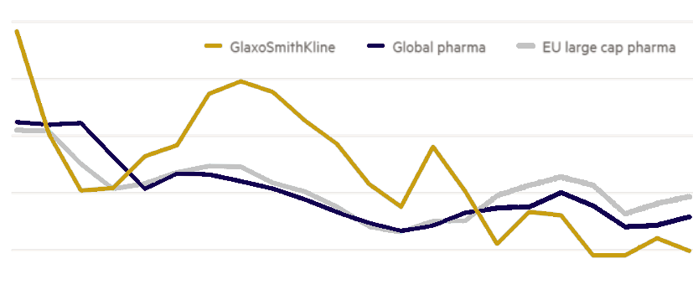
COMPETITOR ANALYSIS
The Pharmaceutical industry is driven by R&D to find the new „STAR” products.
R&D PRODUCTIVITY OF GSK
2.5
Prevention is more and more important in the pharmaceutical industry
2.0
1.5
R&D is a key success factor in the pharmaceutical indsutry
1.0
0.5
The number of new patents is a competitive advantage
1999
2005
2010
2015
2020
GSK is at a significant disadvantage compared to its main competitors regarding R&D.

Slide 9
COMPANY ANALYSIS: REVENUE BY DIVISION
The Company's revenues shifted towards Vaccines and Consumer health division.
GKS’s revenue by division in 2016
GKS’s revenue by division in 2020
Pharma:
Specialty medicines
Consumer healthcare:
OTC
Vaccines
CONCLUSION 2
There was an 8% drop in Pharmaceuticals revenue, a 5% increase in Vaccines and a 3% increase in Consumer healthcare

Slide 10


COMPANY ANALYSIS: BCG MATRIX
Each division performs acceptable, but there is room for improvement .
high
CORE STRENGHTS
V
One of the largest pharma company: 7% global share
1
2
150 countries, 100 000 employees
P
3
20 late stage drugs
?
Nine power brands in Consumer Healthcare
4
BUSINESS GROWTH
CHALLENGES
CH
1
Covid-19 late vaccine
2
Cancer research faild
3
Of 125 top managers, 100 changed
low
high
4
Drop in share price
RELATIVE MARKET SHARE

Slide 11
COMPANY ANALYSIS: BCG MATRIX
Each division performs acceptable, but there is room for improvement .
high
CORE STRENGHTS
V
One of the largest pharma company: 7% global share
V
1
2
150 countries, 100 000 employees
P
P
3
20 late stage drugs
?
Nine power brands in Consumer Healthcare
4
BUSINESS GROWTH
CHALLENGES
CH
1
Covid-19 late vaccine
2
Cancer research faild
3
Of 125 top managers, 100 changed
low
high
4
Drop in share price
RELATIVE MARKET SHARE

Slide 12
CONCLUSION OF THE ANALYSIS
NEED TO RESTRUCTURE GSK
COMPANY ANALYSIS: BCG MATRIX
Each division performs acceptable, but there is room for improvement .
high
CORE STRENGHTS
V
One of the largest pharma company: 7% global share
V
1
2
150 countries, 100 000 employees
P
P
3
20 late stage drugs
?
Nine power brands in Consumer Healthcare
4
BUSINESS GROWTH
CHALLENGES
CH
1
Covid-19 late vaccine
2
Cancer research faild
3
Of 125 top managers, 100 changed
low
high
4
Drop in share price
RELATIVE MARKET SHARE

Slide 13
01
ANALYSIS
02
ALTERNATIVES
STRUCTURE
03
RECOMMENDATION
04
IMPLEMENTATION
05
IMPACT

Slide 14
DEVELOPMENT OF ALTERNATIVES
Based on the analysis, GSK has 5 restructuring alternatives.
PHARMACEUTICALS
VACCINES
CONSUMER HEALTHCARE
PRE-SPIN-OFF

Slide 15
DEVELOPMENT OF ALTERNATIVES
Based on the analysis, GSK has 5 restructuring alternatives.
PHARMACEUTICALS
VACCINES
CONSUMER HEALTHCARE
PRE-SPIN-OFF
PHARMACEUTICALS
VACCINES
CONSUMER HEALTHCARE
POST-SPIN-OFF

Slide 16
DEVELOPMENT OF ALTERNATIVES
Based on the analysis, GSK has 5 restructuring alternatives.
PHARMACEUTICALS
VACCINES
CONSUMER HEALTHCARE
PRE-SPIN-OFF
PHARMACEUTICALS
VACCINES
CONSUMER HEALTHCARE
POST-SPIN-OFF
PHARMACEUTICALS
VACCINES
CONSUMER HEALTHCARE
NEW ALTERNATIVE

Slide 17
DEVELOPMENT OF ALTERNATIVES
Based on the analysis, GSK has 5 restructuring alternatives.
PHARMACEUTICALS
VACCINES
CONSUMER HEALTHCARE
PRE-SPIN-OFF
PHARMACEUTICALS
VACCINES
CONSUMER HEALTHCARE
POST-SPIN-OFF
PHARMACEUTICALS
VACCINES
CONSUMER HEALTHCARE
NEW ALTERNATIVE
PHARMACEUTICALS
VACCINES
CONSUMER HEALTHCARE
NEW ALTERNATIVE

Slide 18
DEVELOPMENT OF ALTERNATIVES
Based on the analysis, GSK has 5 restructuring alternatives.
PHARMACEUTICALS
VACCINES
CONSUMER HEALTHCARE
PRE-SPIN-OFF
PHARMACEUTICALS
VACCINES
CONSUMER HEALTHCARE
POST-SPIN-OFF
PHARMACEUTICALS
VACCINES
CONSUMER HEALTHCARE
NEW ALTERNATIVE
PHARMACEUTICALS
VACCINES
CONSUMER HEALTHCARE
NEW ALTERNATIVE
PHARMACEUTICALS
VACCINES
CONSUMER HEALTHCARE
ELLIOTT’S WISH

Slide 19
DEVELOPMENT OF ALTERNATIVES
Based on the analysis, GSK has 5 restructuring alternatives.
PHARMACEUTICALS
VACCINES
CONSUMER HEALTHCARE
IMPORTANT TREND IN HEALTHCARE
IMPORTANCE OF PREVENTION*: GROWING
*VACCINES ARE THE MOST IMPORTANT SUBSECTOR OF PREVENTION
PHARMACEUTICALS
VACCINES
CONSUMER HEALTHCARE
PHARMACEUTICALS
VACCINES
CONSUMER HEALTHCARE
PHARMACEUTICALS
VACCINES
CONSUMER HEALTHCARE
PHARMACEUTICALS
VACCINES
CONSUMER HEALTHCARE

Slide 20
DEVELOPMENT OF ALTERNATIVES
Based on the analysis, GSK has 5 restructuring alternatives.
PHARMACEUTICALS
VACCINES
CONSUMER HEALTHCARE
IMPORTANT TREND IN HEALTHCARE
IMPORTANCE OF PREVENTION*: GROWING
*VACCINES ARE THE MOST IMPORTANT SUBSECTOR OF PREVENTION
PHARMACEUTICALS
VACCINES
CONSUMER HEALTHCARE
PHARMACEUTICALS
VACCINES
CONSUMER HEALTHCARE
PHARMACEUTICALS
VACCINES
CONSUMER HEALTHCARE
PHARMACEUTICALS
VACCINES
CONSUMER HEALTHCARE

Slide 21
DEVELOPMENT OF ALTERNATIVES
Based on the analysis, GSK has 5 restructuring alternatives.
PHARMACEUTICALS
VACCINES
CONSUMER HEALTHCARE
EQUITY VALUE BASED ON MARKET VALUATION
£20,9 BILL.
EQUITY VALUE BASED ON FORECASTED CASH-FLOW
£24,2–31.4 BILL.
GSK COULD SELL THE SEGMENT WITH A DOWNSIDE DISACOUNT
PHARMACEUTICALS
VACCINES
CONSUMER HEALTHCARE
PHARMACEUTICALS
VACCINES
CONSUMER HEALTHCARE
PHARMACEUTICALS
VACCINES
CONSUMER HEALTHCARE
PHARMACEUTICALS
VACCINES
CONSUMER HEALTHCARE

Slide 22
DEVELOPMENT OF ALTERNATIVES
Based on the analysis, GSK has 5 restructuring alternatives.
PHARMACEUTICALS
VACCINES
CONSUMER HEALTHCARE
EQUITY VALUE BASED ON MARKET VALUATION
£20,9 BILL.
EQUITY VALUE BASED ON FORECASTED CASH-FLOW
£24,2–31.4 BILL.
GSK COULD SELL THE SEGMENT WITH A DOWNSIDE DISACOUNT
PHARMACEUTICALS
VACCINES
CONSUMER HEALTHCARE
PHARMACEUTICALS
VACCINES
CONSUMER HEALTHCARE
PHARMACEUTICALS
VACCINES
CONSUMER HEALTHCARE
PHARMACEUTICALS
VACCINES
CONSUMER HEALTHCARE

Slide 23
01
ANALYSIS
02
ALTERNATIVES
STRUCTURE
03
RECOMMENDATION
04
IMPLEMENTATION
05
IMPACT

Slide 24
3 SEPARATE ENTITIES
The recommendation is based on 3 different entities: pharma, vaccines and consumer healthcare.
MAIN CHALLENGE: COMPROMISE BETWEEN WALMSLEY AND ELLIOTT

Slide 25
3 SEPARATE ENTITIES
The recommendation is based on 3 different entities: pharma, vaccines and consumer healthcare.
MAIN CHALLENGE: COMPROMISE BETWEEN WALMSLEY AND ELLIOTT
WHAT DID ELLIOTT ASK FROM GSK?

Slide 26
3 SEPARATE ENTITIES
The recommendation is based on 3 different entities: pharma, vaccines and consumer healthcare.
MAIN CHALLENGE: COMPROMISE BETWEEN WALMSLEY AND ELLIOTT
WHAT DID ELLIOTT ASK FROM GSK?
WALMSLEY’S PREFERENCE
1
SAME LEADERSHIP: CEO – WALMSLEY
2
CONSUMER HEALTHCARE: NOT SOLD

Slide 27
3 SEPARATE ENTITIES
The recommendation is based on 3 different entities: pharma, vaccines and consumer healthcare.
MAIN CHALLENGE: COMPROMISE BETWEEN WALMSLEY AND ELLIOTT
WHAT DID ELLIOTT ASK FROM GSK?
WALMSLEY’S PREFERENCE
ELLIOTT’S PREFERENCE
1
SAME LEADERSHIP: CEO – WALMSLEY
3
NON-EXECUTIVE DIRECTORS IN BOARD
2
CONSUMER HEALTHCARE: NOT SOLD
4
PHARMA & VACCINES: NO INTEGRATION
5
BIGGER R&D BUDGET FOR GSK

Slide 28
01
ANALYSIS
02
ALTERNATIVES
STRUCTURE
03
RECOMMENDATION
04
IMPLEMENTATION
05
IMPACT

Slide 29
HUMAN RESOURCES: RESTRUCTURING
To grow, we must focus on the people within the Organization.
GlaxoSmithKline

Slide 30
HUMAN RESOURCES: RESTRUCTURING
To grow, we must focus on the people within the Organization.
PHARMACEUTICALS
GlaxoSmithKline
VACCINES
CONSUMER HEALTH

Slide 31
HUMAN RESOURCES: RESTRUCTURING
To grow, we must focus on the people within the Organization.
1.
NON-EXECUTIVE BOARD MEMBERS
PHARMACEUTICALS
GlaxoSmithKline
2.
FIND THE RIGHT EXPERTS
VACCINES
3.
CONSUMER HEALTH
KEEP EMPLOYEES

Slide 32
HUMAN RESOURCES: RESTRUCTURING
To grow, we must focus on the people within the Organization.
1.
1. Industry experts
2. Scientists
3. Investors
NON-EXECUTIVE BOARD MEMBERS
PHARMACEUTICALS
GlaxoSmithKline
2.
FIND THE RIGHT EXPERTS
VACCINES
3.
CONSUMER HEALTH
KEEP EMPLOYEES

Slide 33
HUMAN RESOURCES: RESTRUCTURING
To grow, we must focus on the people within the Organization.
1.
1. Industry experts
2. Scientists
3. Investors
NON-EXECUTIVE BOARD MEMBERS
PHARMACEUTICALS
2.
1. Partnering with universities
2. Organize events and competition
3. Target great minds
GlaxoSmithKline
FIND THE RIGHT EXPERTS
VACCINES
3.
CONSUMER HEALTH
KEEP EMPLOYEES

Slide 34
HUMAN RESOURCES: RESTRUCTURING
To grow, we must focus on the people within the Organization.
1.
1. Industry experts
2. Scientists
3. Investors
NON-EXECUTIVE BOARD MEMBERS
PHARMACEUTICALS
2.
1. Partnering with universities
2. Organize events and competition
3. Target great minds
GlaxoSmithKline
FIND THE RIGHT EXPERTS
VACCINES
1. Compensation
2. Motivation
3. Organizational culture
3.
CONSUMER HEALTH
KEEP EMPLOYEES

Slide 35

PR: JUDGEMENT OF GSK
GSK should be the leader in collaboration and supporter of the healthcare ecosystem.
IMPROVEMENT BASED ON THE VCI MODEL
CULTURE
IMAGE
VISION

Slide 36



PR: JUDGEMENT OF GSK
GSK should be the leader in collaboration and supporter of the healthcare ecosystem.
IMPROVEMENT BASED ON THE VCI MODEL
VISION: conveyed image, the values showed outward by the Company.
CULTURE
IMAGE
VISION
CULTURE: „iceberg” – visible elements, values, routines, beliefes.
IMAGE: reflection of the company, external perceptions..

Slide 37
PR: JUDGEMENT OF GSK
GSK should be the leader in collaboration and supporter of the healthcare ecosystem.
IMPROVEMENT BASED ON THE VCI MODEL
VISION: conveyed image, the values showed outward by the Company.
CULTURE
IMAGE
VISION
CULTURE: „iceberg” – visible elements, values, routines, beliefes.
IMAGE: reflection of the company, external perceptions..
Becoming the center of collaboration and an active player in the
healthcare ecosystem.

Slide 38
OPERATIONS: TIMETABLE
For the upcoming 2 years GSK have to focus on inner development, instead of dowsizing.
# | ACTIVITY | 2023/1 |  |  |  | 2023/2 |  |  |  | 2024/1 |  |  |  | 2024/2
1. | Look for new board members
2. | Working with consulting partners
3. | Working experts on the field of HR
4. | Restructuring
5. | Partnering with universities
6. | Building out collaboration
7. | Employee branding
8. | Cultural education
9. | R&D development

Slide 39
STRATEGY: CONTINGENCY PLAN
GSK’s restructuring has many risks and challenges.
RISKS
MITIGATION
SOLUTION
1
Lack of synergies in the Company.
Building collaborations.
Impact
2
2
Low return on R&D.
Attract the best experts.
4
3
Organizational resistance.
Motivating and compensating employees.
1
Working with consultants and experts.
3
4
Difficulties of collaboration.
Probability

Slide 40
FINANCE: EFFECTS
In order to implement the strategy, the company have to invest 657 – 709 million £
Overall extra cost in FY23
1. Cost of organizational restructuring
2. Personnel expenses
3. R&D budget
4. OOE
1
The estimated cost of creating new entities is 150 – 200 million £
2
Increased personnel expenses due to the need for new employees: 250 – 300 million £
3
Increase of the R&D budget on a yearly basis: 150 – 200 million £
Other operating expenses like employee education will increase as well: 7 – 9 million £
4

Slide 41
01
ANALYSIS
02
ALTERNATIVES
STRUCTURE
03
RECOMMENDATION
04
IMPLEMENTATION
05
IMPACT

Slide 42
FINANCIAL IMPACT
GSK’s equity value is £144 billion.
Financial Forecast
Declining profit in the initial phase of the transformation
From FY 24 the operating profit will increase
Equity value: 144 billion pounds

Slide 43
EXECUTIVE SUMMARY
Executive summary with the most important elements of the solution.
ANALYSIS
NEED TO RESTRUCTURE GSK
ALTERNATIVES
5 ALTERNATIVES: PRE-SPIN-OFF, POST-SPIN-OFF, ELLIOTT’S WISH, 2X NEW ALTERNATIVES
RECOMMENDATION
3 SEPARATE ENTITIES
IMPLEMENTATION
1. HUMAN RESOURCES: RESTRUCTURING
2. PR: JUDGEMENT OF GSK
3. OPERATIONS: TIMETABLE
4. STRATEGY: CONTINGENCY PLAN
5. FINANCE: EFFECTS
IMPACT
EQUITY VALUE OF £144 BILL.

Slide 44
QUESTIONS
SPINNING OFF CONSUMER HEALTHCARE IS A GOOD IDEA? YES.
HOW CAN GSK REGAIN ITS POSITION IN THE INDUSTRY? 3 DIFFERENT ENTITIES.
HOW TO MAKE GSK BE INNOVATIVE AND EFFICIENT? DIFFERENT ENTITIES: DIFFERENT CHALLENGES.
HOW TO CONVINCE ELLIOTT ABOUT THE PLAN? COMPROMISE (MAIN CHALLENGE).
EXECUTIVE SUMMARY
Executive summary with the most important elements of the solution.
ANALYSIS
NEED TO RESTRUCTURE GSK
ALTERNATIVES
5 ALTERNATIVES: PRE-SPIN-OFF, POST-SPIN-OFF, ELLIOTT’S WISH, 2X NEW ALTERNATIVES
RECOMMENDATION
3 SEPARATE ENTITIES
IMPLEMENTATION
1. HUMAN RESOURCES: RESTRUCTURING
2. PR: JUDGEMENT OF GSK
3. OPERATIONS: TIMETABLE
4. STRATEGY: CONTINGENCY PLAN
5. FINANCE: EFFECTS
IMPACT
EQUITY VALUE OF £144 BILL.

Slide 45
GlaxoSmithKline
THE FUTURE OF EMMA WALMSLEY
JOHN MOLSON MBA INTERNATIONAL CASE COMPETITION – CASE 5
2023

Slide 46
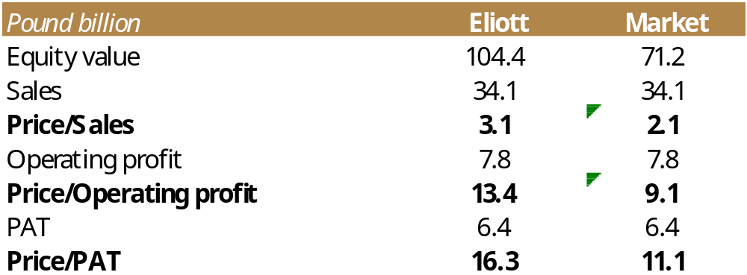
COMPANY`S VALUATION

Slide 47
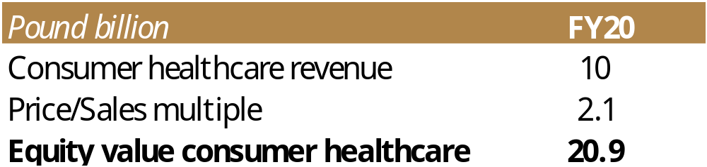
CONSUMER HEALTHCARE`S VALUATION

Slide 48
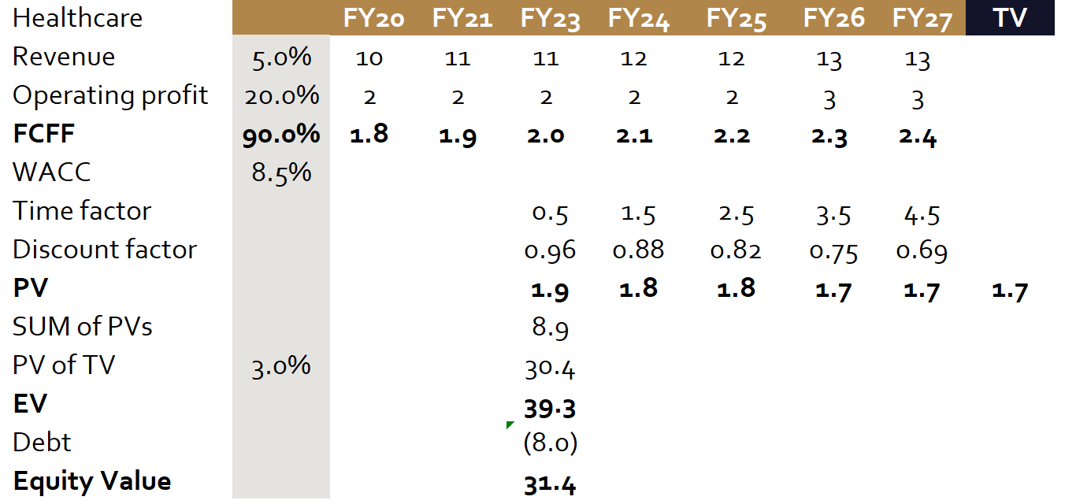
CONSUMER HEALTHCARE`S VALUATION – BASE CASE

Slide 49
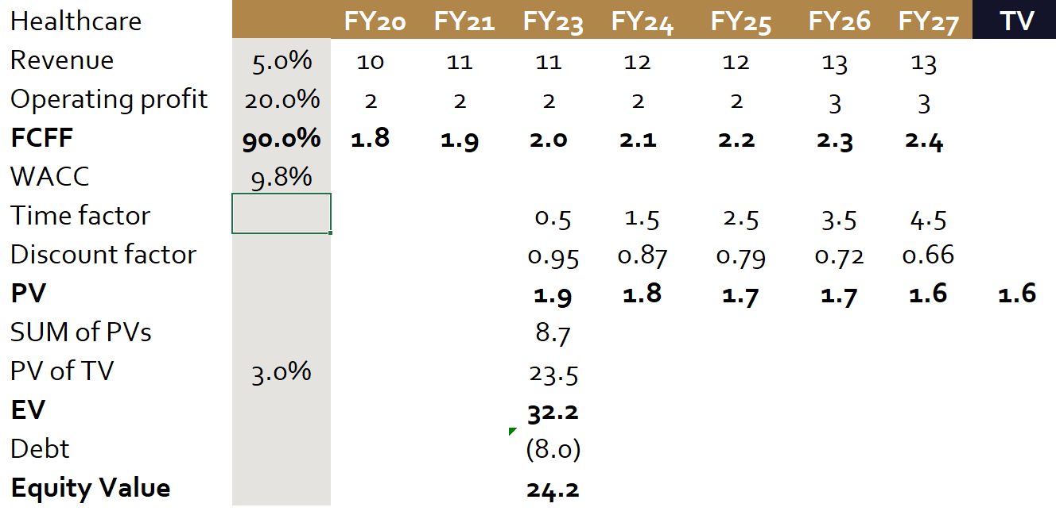
CONSUMER HEALTHCARE`S VALUATION – PESSIMISTIC CASE

Slide 50
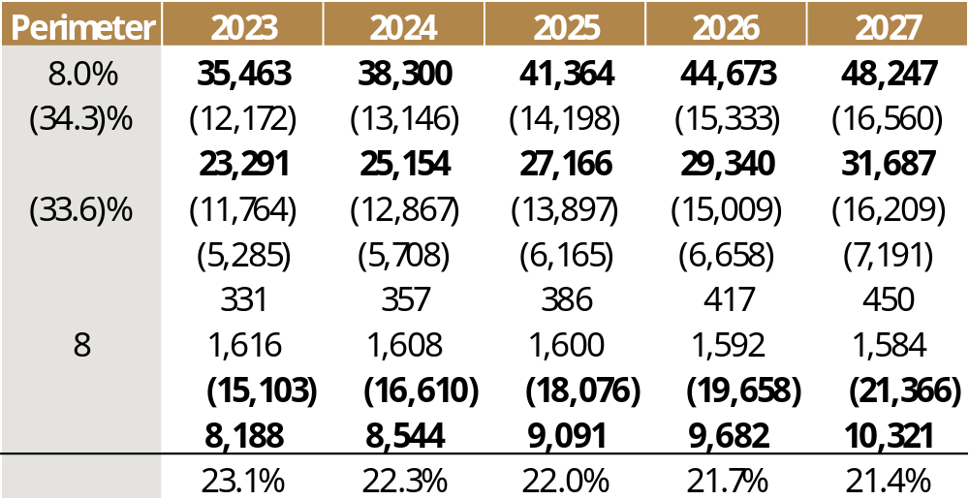
FINANCIAL FORECAST

Slide 51
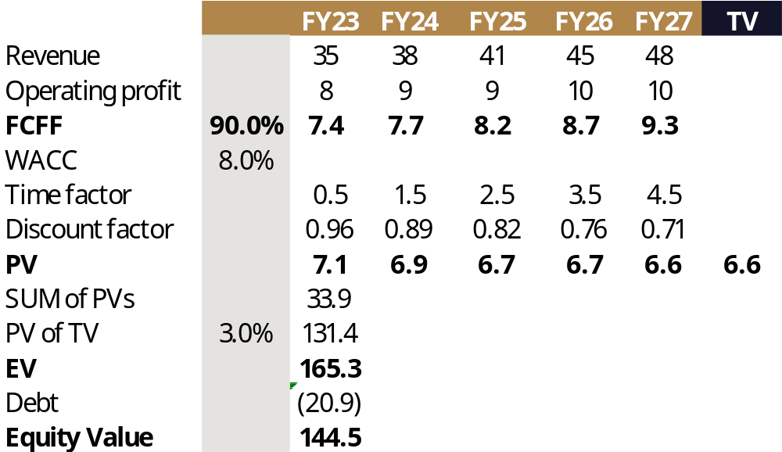
VALUATION – BASE CASE

Slide 52
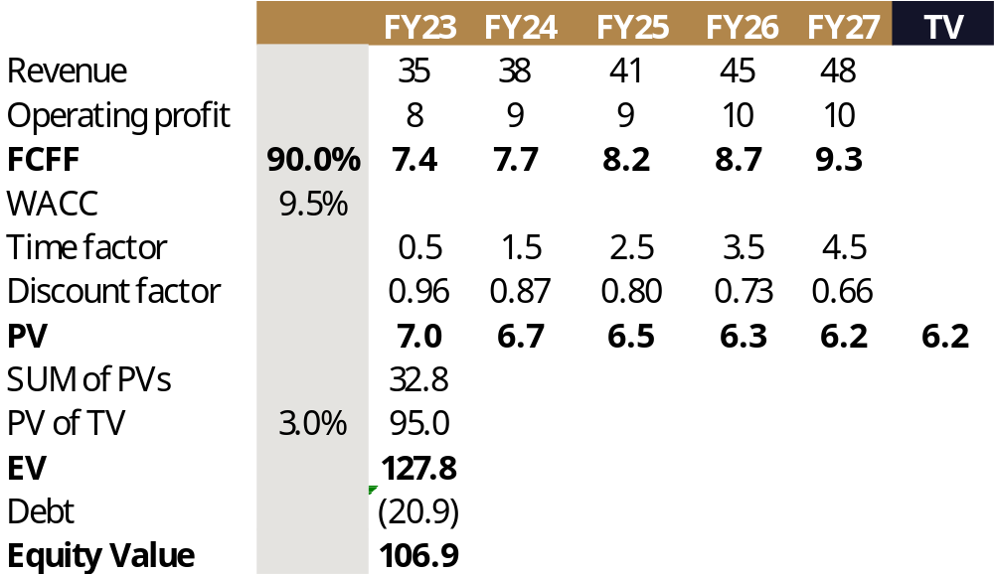
VALUATION – PESSIMISTIC CASE

