Slide 1


EGADE SOLUTIONS
CASE 4: Blueland

Slide 2


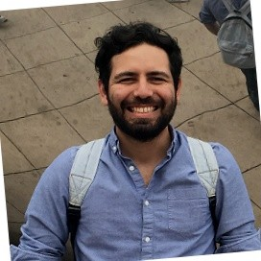

Our team
RICARDO
ARGÜELLES
Kevin
MELLADO
Luis
SALINAS
Melissa
JARRIN

Slide 3
Agenda
Challenges
01
Brainstorm
02
Alternatives
03
Recommendation
04
Implementation
05
Q&A
06
Notes:
We need to understand the bases of Artificial intelligence to understand it’s potencial
We need to understand where we stand. To see what are the challenges we Will be facing in the near future

Slide 4
CHALLENGES
At Walmart
Not enough time
No cooking experience (young people)
Fair recommendations
While Traveling
Airbnb doesn’t have food
Walk trough a Warehouse
CHALLENGES
BRAINSTORM
RECOMMENDATION
IMPLEMENTATION
SUMMARY

Slide 5
BRAINSTORM
1. Facial Recognition
2. Digital in site Market
3. Airbnb
Collaboration
5. Creator’s Hall
4. BlockChain
MAKE IT ACTIONABLE
NOT THE FIRST NOR LAST
DIGITAL ERA
MAKE IT ACTIONABLE
EXECUTE & AUTOMATE
NEW OPORTUNITIES
Make it easy
All the Halls to be digital
Your shopping list is ready
Traceability all the way
Marketing era
CHALLENGES
BRAINSTORM
RECOMMENDATION
IMPLEMENTATION
SUMMARY

Slide 6
Facial recognition
Pros
No more cards
Smooth experience
Cons
Software development
Hardware needs
Possible failures
1. Facial Recognition
GET ALIGNED AND ORGANIZED
Show your smile
CHALLENGES
BRAINSTORM
RECOMMENDATION
IMPLEMENTATION
SUMMARY

Slide 7
Digital In-Site MARKET
2. Digital in site Market
Pros
People don’t use cars
Technological aspect
Cons
Big change
People likes to view physical things
DIGITAL ERA
All the Halls to be digital
CHALLENGES
BRAINSTORM
RECOMMENDATION
IMPLEMENTATION
SUMMARY

Slide 8
AIRBNB collaboration
3. Airbnb
Collaboration
Pros
Food at your arrival
Better experience
Cons
A lot of logistics
Not enough Walmarts’ for every Airbnb
MAKE IT ACTIONABLE
Your shipping list ready at your arrival
CHALLENGES
BRAINSTORM
RECOMMENDATION
IMPLEMENTATION
SUMMARY

Slide 9
BLOCKCHAIN
Pros
Track sustainability
Only trusted products
Cons
Software development
Revenue
4. BlockChain
EXECUTE & AUTOMATE
Traceability all the way
CHALLENGES
BRAINSTORM
RECOMMENDATION
IMPLEMENTATION
SUMMARY

Slide 10

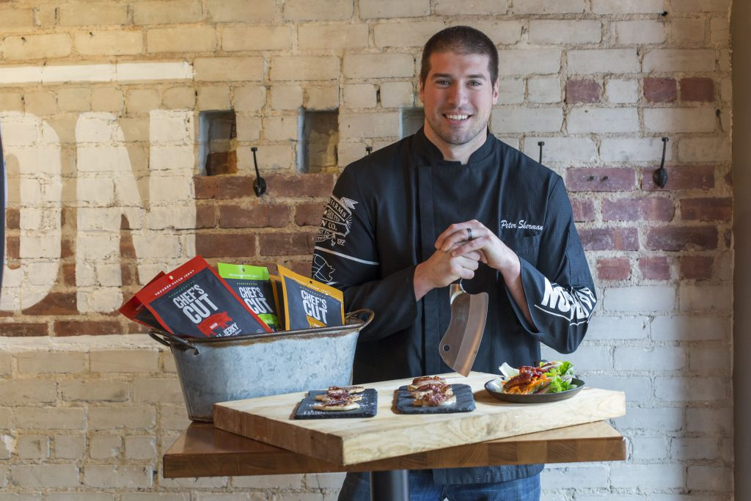

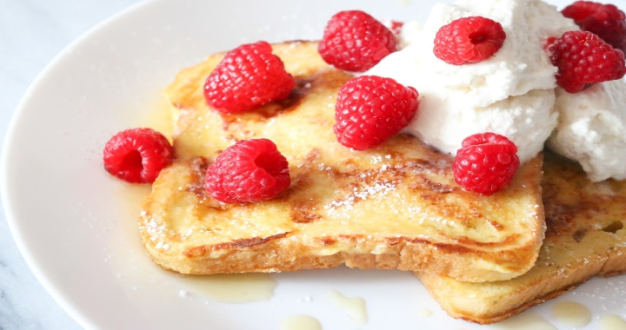
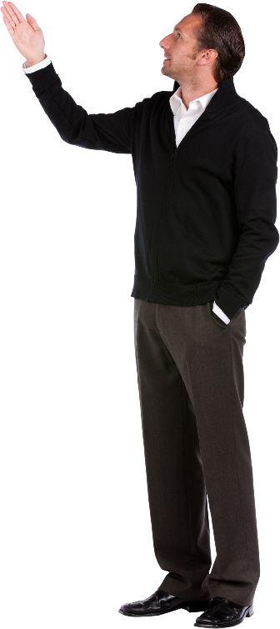
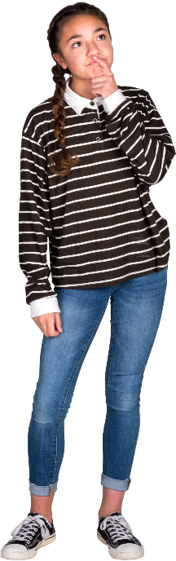
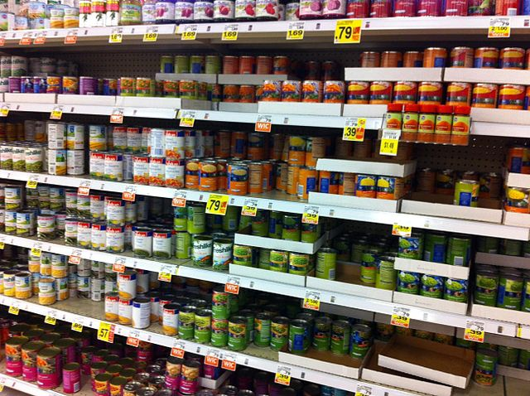
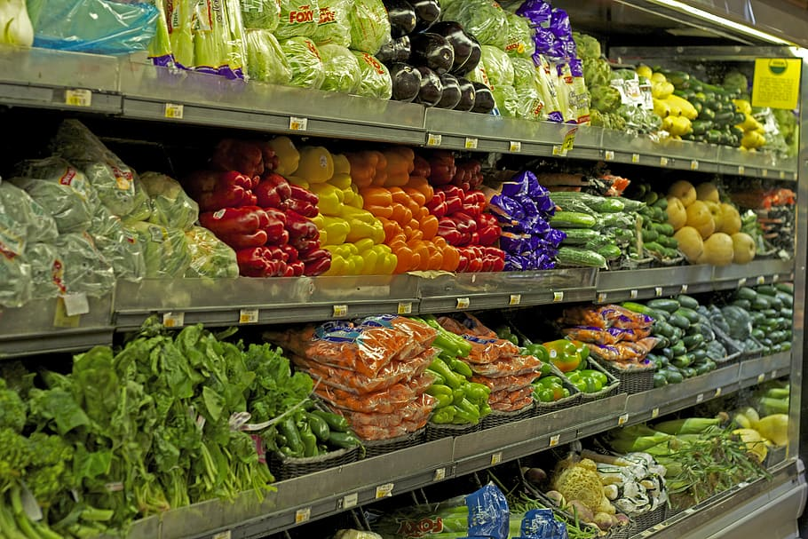
CREATOR’s HALL
CHALLENGES
BRAINSTORM
RECOMMENDATION
IMPLEMENTATION
SUMMARY

Slide 11





Shopping Process – Creators Hall
Tony’s cognitive path.
Tony knows he can be supported on his future meal planning through influencers, which will start following from now on!
Walks out
6
5
Tony picks good ideas for other meal's special occasions (Thanksgiving, HNL games) and gets the actual recipes information. (QR, NFC).
Information is provided
Assisted Shopping
4
Tony watches one of the influencer’s video and decides to follow recipe & ingredients.
Creators Hall
3
Tony notices the Creator’s Hall, walks in.
Shopping List
2
He wanders around the food halls.
Tony arrives to Walmart with just an idea of what to buy for his weekly meals. He's not a very good cook.
Shopping
1
CHALLENGES
BRAINSTORM
RECOMMENDATION
IMPLEMENTATION
SUMMARY

Slide 12
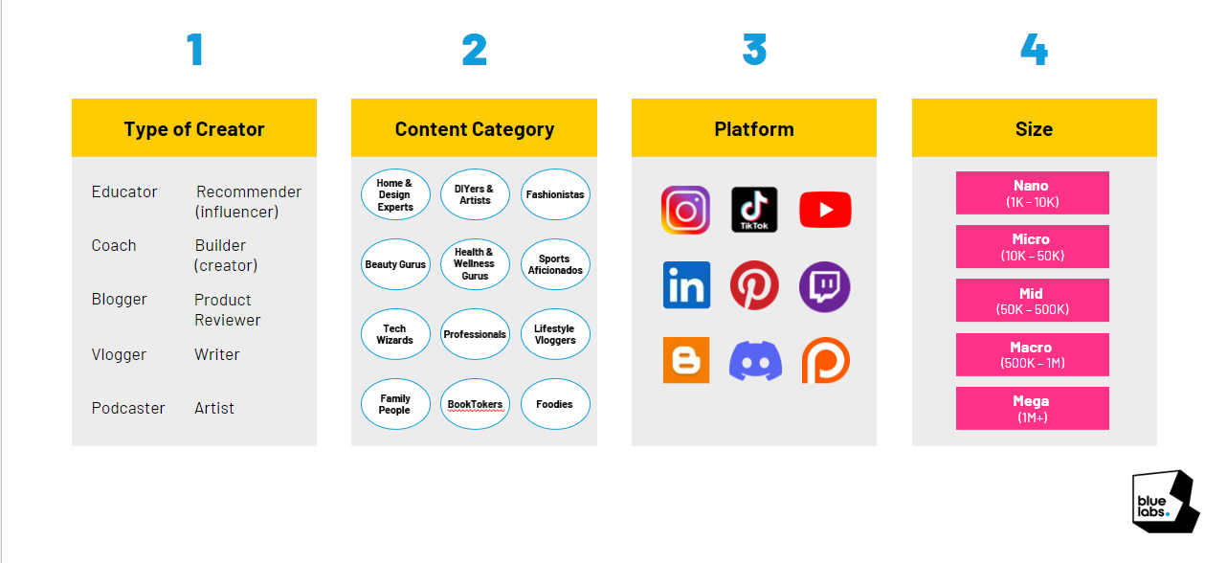
WHAT ABOUT CREATORS?
CHALLENGES
BRAINSTORM
RECOMMENDATION
IMPLEMENTATION
SUMMARY
Notes:
What type of creators are we gonna choose according creators classification you gave us. Nano and micro because they have more engagement of 4 and 2% respectively.

Slide 13
WHAT ABOUT CREATORS?
Problem
Get more followers
Recurring content
Get more engagement
Trust
Solution
New audience
Upload recipe videos
Create your own brand
Get likes, comments from people who tried your recipe
CHALLENGES
BRAINSTORM
RECOMMENDATION
IMPLEMENTATION
SUMMARY
Notes:
And in a future we Will attract other types of creators, fashionistas, who Will suggest colors that get well together, depending on the ocassion, on the type of body, then home and design experts who can help you to decorate at home your bedroom, living room, etc

Slide 14
Business plan
JAN ‘23
FEB ‘23
MAR ‘23
APR ‘23
MAY ‘23
JUN ‘23
JUL ‘23
AUG ‘23
SEP ‘23
OCT ‘23
NOV ‘23
DEC ‘23
Develop Strategy
We need to create a win-win situation for creators and Walmart
Develop the Innovation Acceptance Model
In order to succeed we need to secure customer acceptance
Launched Beta version with continuous iterations
Quick repetitive iterations will redefine the final product
Hone Customer Experience Excellence
With a Blue Ocean Strategy, we will make sure the experience is excellent to retain loyal customers
Escalate Nationwide
Launch new model nation wide
CHALLENGES
BRAINSTORM
RECOMMENDATION
IMPLEMENTATION
SUMMARY

Slide 15
Develop Strategy
JAN ‘23
FEB ‘23
MAR ‘23
APR ‘23
MAY ‘23
JUN ‘23
JUL ‘23
AUG ‘23
SEP ‘23
OCT ‘23
NOV ‘23
DEC ‘23
Develop Business plan
We need to create a win-win situation for creators and Walmart
YOUR TITLE 01
YOUR TITLE 02
YOUR TITLE 03
Private equity has successfully attracted the best and brightest in corporate America, including top performers from Fortune 500 companies and elite strategy and management consulting firms. Top performers at accounting and law firms can also be.
YOUR TITLE 04
Private equity has successfully attracted the best and brightest in corporate America, including top performers from Fortune 500 companies and elite strategy and management consulting firms. Top performers at.
YOUR TITLE 05
Private equity has successfully attracted the best and brightest in corporate America, including top performers from Fortune 500 companies and elite strategy and management consulting firms.
CHALLENGES
BRAINSTORM
RECOMMENDATION
IMPLEMENTATION
SUMMARY

Slide 16
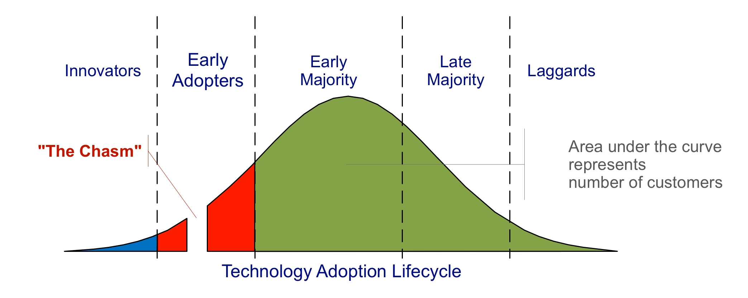
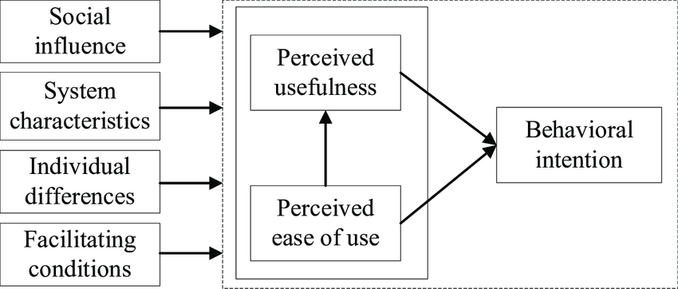
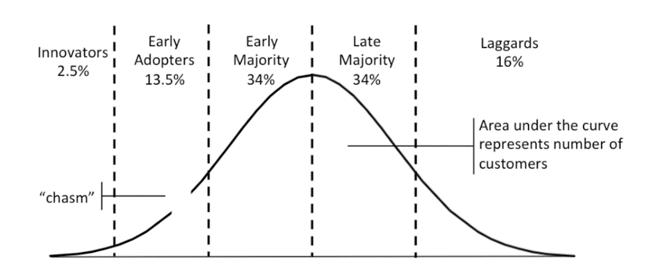
Innovation Acceptance Model
JAN ‘23
FEB ‘23
MAR ‘23
APR ‘23
MAY ‘23
JUN ‘23
JUL ‘23
AUG ‘23
SEP ‘23
OCT ‘23
NOV ‘23
DEC ‘23
Develop the Innovation Acceptance Model
In order to succeed we need to secure customer acceptance
Social Influence
Facilitating Conditions
Perceived Usefulness
Perceived ease of use
Behavioral Intention
16%
CHALLENGES
BRAINSTORM
RECOMMENDATION
IMPLEMENTATION
SUMMARY

Slide 17
Agile Development
JAN ‘23
FEB ‘23
MAR ‘23
APR ‘23
MAY ‘23
JUN ‘23
JUL ‘23
AUG ‘23
SEP ‘23
OCT ‘23
NOV ‘23
DEC ‘23
Launched Beta version with continuous iterations
Test
S1
Design
Test
S2
Design
Test
S3
Design
Define
Deploy
Define
Deploy
Define
Deploy
Sprint 1
Sprint 2
Sprint 3
Launch Hall & UX for
Launch IMC plan
Open up for creators
CHALLENGES
BRAINSTORM
RECOMMENDATION
IMPLEMENTATION
SUMMARY

Slide 18
Customer Journey
JAN ‘23
FEB ‘23
MAR ‘23
APR ‘23
MAY ‘23
JUN ‘23
JUL ‘23
AUG ‘23
SEP ‘23
OCT ‘23
NOV ‘23
DEC ‘23
Hone Customer Experience Excellence
Website
Community
Manager
Loyalty
Program
Digital
TOUCHPOINTS
Paid
Content
Creators
Media
Chat
Online
Advertising
Service
E-mail
Search
Survey
AWARENESS
CONSIDERATION
ACQUISITION
SERVICE
LOYALTY
Physical
Advertising
Direct
Delivery
Call Center
Offers in
Invoice
Physical
TOUCHPOINTS
Word of
Mouth
Easy check-out
process
Retail
Stores
Word of Mouth
Clear
selection
Mailings
CHALLENGES
BRAINSTORM
RECOMMENDATION
IMPLEMENTATION
SUMMARY

Slide 19
Escalate Natiowide
JAN ‘23
FEB ‘23
MAR ‘23
APR ‘23
MAY ‘23
JUN ‘23
JUL ‘23
AUG ‘23
SEP ‘23
OCT ‘23
NOV ‘23
DEC ‘23
Escalate Nationwide
Launch new model nation wide
Millenial Location
01
They are more keen to buy from creators
High Density population
02
Higher density tends to have more creators and more audience
Suburbs
03
Once it has been tried on strategic locations we move to the rest of the locations in Canada
CHALLENGES
BRAINSTORM
RECOMMENDATION
IMPLEMENTATION
SUMMARY
CHALLENGES
BRAINSTORM
RECOMMENDATION
IMPLEMENTATION
SUMMARY

Slide 20

summary
A lot of possibilities, many megatrends a lot of technology improvements for Walmart.
CHALLENGES
BRAINSTORM
RECOMMENDATION
IMPLEMENTATION
SUMMARY

Slide 21
Thank you
Questions

Slide 22
Images from:
This Photo by Unknown Author is licensed under CC BY-NC-ND
This Photo by Unknown Author is licensed under CC BY-NC
This Photo by Unknown Author is licensed under CC BY-SA-NC
This Photo by Unknown Author is licensed under CC BY
This Photo by Unknown Author is licensed under CC BY-SA-NC
This Photo by Unknown Author is licensed under CC BY-NC
This Photo by Unknown Author is licensed under CC BY
This Photo by Unknown Author is licensed under CC BY-NC-ND
This Photo by Unknown Author is licensed under CC BY-NC
This Photo by Unknown Author is licensed under CC BY-SA
This Photo by Unknown Author is licensed under CC BY-SA

