Slide 1
blue Labs: transforming the future of retail
UCT Consulting
Minaz Munshi, Emanuela Duarte, Jane Lim, Michael Rissik

Slide 2
Agenda
1 | Blue Labs today | Minaz
2 | Analysis | Emanuela
3 | Alternatives & recommendations | Minaz
4 | Implementation plan | Michael
5 | Financial analysis & risks | Jane
6 | Close out | Minaz

Slide 3
The journey of blue labs
Walmart services 80% of Canada with 400 stores serving 1.5M people daily
Blue Labs was created to be the lighthouse and tugboat of Walmart Canada
Incubates disruptive & radical innovations that are customer-centric
Creating innovative solutions to transform the future of how, why, & where people shop
How can Blue Labs shape and disrupt the future of retail to unlock new net revenues streams leveraging the strengths of Walmart Canada?

Slide 4
Value Promise
3-year strategy that enables Blue Labs to build a net new revenue stream and solves pain points of creators through a one-stop platform
$1.8M net present value in 3 years through subscriptions and adverts
2-year payback period through increase in adoption of platform
Continue to build new solutions that are innovative and shape the future of retail

Slide 5
Key issue needs to be overcome
Constantly changing customer needs and retail landscape
Customers are changing the way the way they shop and interact with products and services
The creator economy influencing customer choices
Younger generation prefers experiences over things

Slide 6
Strategic Summary
Recommendation:
Launch a creator design studio for lifestyle creators of all levels
Build the walmartcreator.com platform that aims to develop, educate, and build with lifestyle creators
The platform will assist:
  Nano creators to scale and build their following
  Micro to macro to scale their following and diversify revenue
  Mega creators to get access to potential shelf space in Walmart
Macro and mega creators have the opportunity to participate in in-stores events that allow them to interact with customers and showcase their products

Slide 7
Business Analysis
Emanuela Duarte

Slide 8

VALUE PROPOSITION
Who is Walmart Canada?
A giant retail player
Selling online and offline
Walmart created an eco-system!
Size and scale
22 countries
E-commerce player
Families (low incom
Convenience
Affordable products
On-line and offline
Clean and green
Who are Walmart actual customers?
Families (low income)
Busy people
In sub-urbans areas

Slide 9
CUSTOMER SEGMENTATION
Who are our actual customers?
Who might be our future customers?
Imigration
Families (low income)
Busy people
In sub-urbans areas
Families and singles
Still busy people
In suburban or urban areas
New generations

Slide 10
What do customers aspire?
Experiences
Passion/
Motivation
Gen Z
Young consumers (less than 25y)
Less money to spend
Very sustainable concerns
Influencing buying decisions
Millenials
Young consumers (25 - 41)
More money to spend
Sustainable concerns
Buyers
72% of millennials prefer to spend money on experiences than on material things
Gen X
Mature consumers (lmore than 41y)

Slide 11
What do customers aspire?
Experiences
Passion/
Motivation
Gen Z
Young consumers (less than 25y)
Less money to spend
Very sustainable concerns
Influencing buying decisions
Millenials
Young consumers (25 - 41)
More money to spend
Sustainable concerns
Buyers
72% of millennials prefer to spend money on experiences than on material things
Gen X
Mature consumers (lmore than 41y)
What if they come from different countries?
They will probably appreciate some help on being integrated

Slide 12
What ABOUT OUR CREATORS?
Size of Following
Engagement
NANO
(1K-10K)
MICRO
(10K-50K)
MID
(50K-500K)
MACRO
(500K-1M)
MEGA
(1M+)
4%
2%
1.6%
1.3%)
0.8%

Slide 13
What ABOUT OUR CREATORS?
Size of Following
Engagement
Pain Points
NANO
(1K-10K)
MICRO
(10K-50K)
MID
(50K-500K)
MACRO
(500K-1M)
MEGA
(1M+)
4%
2%
1.6%
1.3%)
0.8%
Hard to get noticed
Hard to gain experience
Hard to build a loyal network
Limited income potential on social media
Need new income streams
Risk that their platform may become obsolete
Need managers they can trust
Difficult to produce their own products
Difficult to get products into well recognized stores

Slide 14
What ABOUT OUR CREATORS?
Size of Following
Engagement
Pain Points
Trainning and supports
NANO
(1K-10K)
MICRO
(10K-50K)
MID
(50K-500K)
MACRO
(500K-1M)
MEGA
(1M+)
4%
2%
1.6%
1.3%)
0.8%
Hard to get noticed
Hard to gain experience
Hard to build a loyal network
Limited income potential on social media
Need new income streams
Risk that their platform may become obsolete
Need managers they can trust
Difficult to produce their own products
Difficult to get products into well recognized stores
Motivation on selling
Know-how & facilitators
Walmart!

Slide 15
Alternatives & Recommendations
Minaz munshi

Slide 16



Alternative Recommendations
 | Solves pain points for content creators | Attracts new customer segments | Aligns with customer needs | Utilises strengths of Walmart
Introduce metaverse shopping experience for customers
Build studios for creators to record, film, photograph content
Build and launch concept stores for mega creator

Slide 17



Recommendation 1: Launch a creator design studio for lifestyle creators of all levels
What?
Build and launch a subscription creator design studio for lifestyle creators of all levels to be able to learn, grow, produce, and stock. Utilise strength of footprint to host influential in-store events
Why?
Walmart can provide creators with a one-stop shop solution whilst promoting content that is relevant to its current customer base. Cool in-store events can attract new young customers
Outcome
Solving key pain points for various types on content creators, build new revenue stream (subscriptions), add value to current and new Walmart customers

Slide 18
Implementation
Michael Rissik

Slide 19
What to focus on
 | Changing customer needs & retail landscape
Drivers | Creator Economy
 | Preference for Experiences
 | Evolution of Shopping

Slide 20

Creator design studio
Scale
Develop Products
Products in Store

Slide 21

From nothing to something
Jill
Single, 30 something, from SA
Lifestyle junkie
Fashion
Food
Hiking

Slide 22


Creator.com
Log in
Personal info
  Name
  Location
Platform
  Video
  Audio
Industry
  Fashion
  Lifestyle
  Home
YouTube
Instagram
TikTok

Slide 23
The first step
Scale
Develop Products
Products in Store
<1K
$150
Requirements
Walmart product
Low income / Time sensitive
Young / Single / Urban
New immigrants
Walmart Starter Kit
1 year free access

Slide 24

Action …
YouTube
Instagram
TikTok

Slide 25


How do I ….?

Slide 26

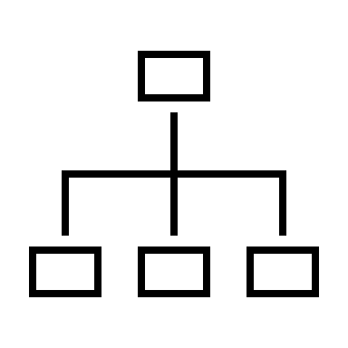

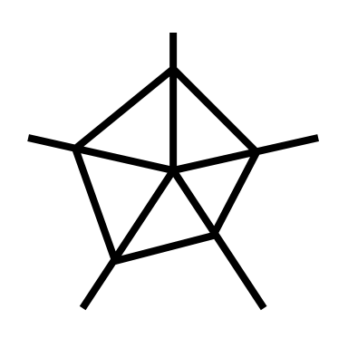
How Am I doing?

Slide 27
What's the next step …
Scale
Develop Products
Products in Store
>10K
$220 p.a.
Facilitate product development
Walmart Fulfilment Services

Slide 28


Hey I want that …
Purchase link

Slide 29
I have made it
Scale
Develop Products
Products in Store
>500k
$220 p.a.
Pop–up Stores
>500k
Access to Walmart shelves
>1m

Slide 30







I’m loving this

Slide 31
Getting the message out there
Channels | Adoption
Creator / Influences expos | Starter Kit
Website | Incentives to share
Emails
In-store
TV / Radio
Shares

Slide 32
Time is of essence
Measure / Timeframe | Year 1 | Year 2 | Year 3
Set up platform
Platform Launch
Enrol creators
Product development
Products in store

Slide 33
Risks, & mitigations
Jane Lim

Slide 34
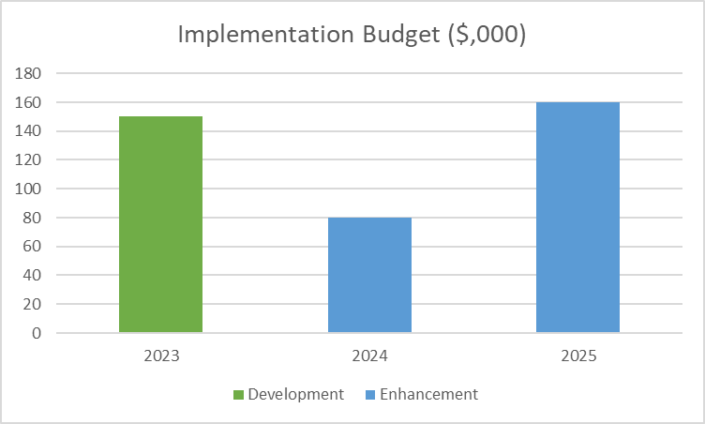
Implementation budget
$390,000 over 3 years
Self-funded

Slide 35
Assumptions
Description | Assumption | Rationale
Average subscription | $185 p.a. | Industry Trend
Creators uptake | 0 in year 1, 0.02% in year 2, 0.04% in year 3 | Conservative measures
Advertisement uptake | 0 in year 1, 20 per week in year 2, 40 per week in year 3 | Existing current capability
Advertisement fee | $500 per advertisement | To entice uptake

Slide 36
Forecast
Forecast | 2023 | 2024 | 2025
Revenue | 0 | 869 | 1738
Subscription |  | 349 | 698
Advertisement |  | 520 | 1040
Expenses | 100 | 180 | 180
Product Development Managers | 0 | 80 | 80
Other Expenses | 100 | 100 | 100
Profit | -100 | 689 | 1558 | NPV $1,814
NPV $1.8M in 3 years, 2 year payback period

Slide 37
Key Risks & mitigations
Tech misalignment
Low adoption
2
Continuous feedback from creators
Targeted marketing and offer complimentary introduction
Probability
1
Impact

Slide 38
Conclusion
Minaz munshi

Slide 39
Value Promise
3-year strategy that enables Blue Labs to build a net new revenue stream and solves pain points of creators through a one-stop platform
$1.8M net present value in 3 years through subscriptions and adverts
2-year payback period through increase in adoption of platform
Continue to build new solutions that are innovative and shape the future of retail

Slide 40
Thank you
UCT Consulting

