Slide 1

BLUE LABS
BGU Consulting
Presented by: Naama Mor-Yosef I Sari Berkowitz I Stephanie Cemal I Gregory Gelfenbuym
Presented to: Bluelabs representatives

Slide 3
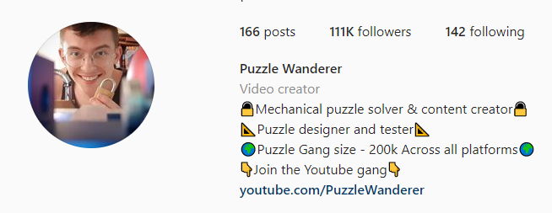
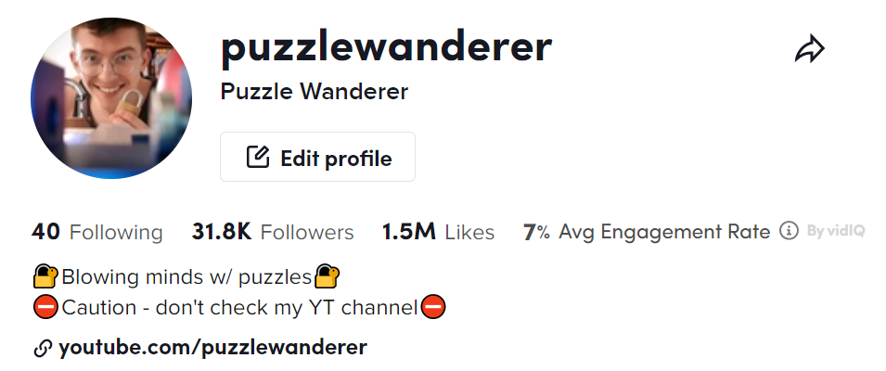
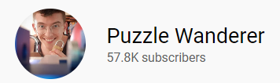
1 out of 4

Slide 4




AGENDA FOR TODAY
Analysis & Alternatives
Recommendations
Implementation
Financial Analysis

Slide 5
KEY ISSUES
How can Blue Labs shape the retail experience of tomorrow ?
Size & Scale
Current infrastrastructure
Revenue Streams
Trends
Involving creator commerce and alternatives

Slide 6
BLUE LABS OBJECTIVES
IMPROVE CUSTOMER NPS
?
GENERATE ALTERNATIVE REVENUE STREAMS
REDUCE COST TRANSFORMATION
LEAD DISRUPTIVE AND RADICAL INNOVATION

Slide 7
WHAT IS THE COMPANY CURRENTLY DOING?
PRODUCT
CUSTOMERS
80% of the population in Canada using Walmart stores
Collaboration with influencers
Location: suburbs
Customer Centric
High customer involvement

Slide 8
CUSTOMER SEGMENTS ANALYSIS
Blue Labs customer centric strategy
Who is the customer?
1
What does it solve?
2
What is the problem?
3

Slide 9

ANALYSIS MILLENNIAL AND GEN Z
Prefer to spend money on experiences
Young
Single
Time & Price sensitive
Meet Bob Smith a millennial

Slide 10

ANALYSIS CONTENT CREATOR
NEEDS
Meet Emma Chamberlain
lifestyle blogger
Popularity
Exposure
Monetization
Stability
Go to market
Capabilities

Slide 11
BLUE LABS INNOVATION PROCESS
Identify
Empathize
Define
Ideate
PROBLEM SPACE
We are here

Slide 12
ALTERNATIVES & RECOMMENDATIONS

Slide 13
ALTERNATIVES
1
2
3
CREATOR ECONOMY
PREFERENCE FOR EXPERIENCES
EVOLUTION OF SHOPPING

Slide 14



ALTERNATIVE 1
CREATOR ECONOMY
Special edition of products
Walmart Avatars
Home of creators

Slide 15
DECISION MATRIX
ALTERNATIVES | Special edition of products | Walmart Avatars | Home of creators
DESIRABILITY
FEASIBILITY
DATABILITY

Slide 16
DECISION MATRIX
ALTERNATIVES | Special edition of products | Walmart Avatars | Home of creators
DESIRABILITY
FEASIBILITY
DATABILITY

Slide 17








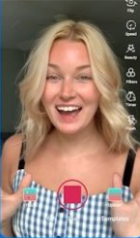



RECOMMENDATION
HOME OF CREATORS

Slide 18

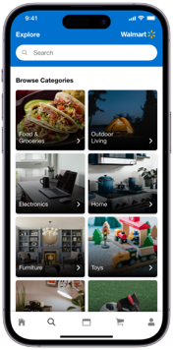
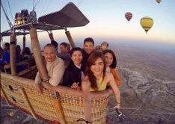
ALTERNATIVE 2
PREFERENCE FOR EXPERIENCES
Virtual reality shopping experience
BuyMe Walmart
Walmart Wonderland

Slide 19
DECISION MATRIX
ALTERNATIVES | Virtual reality shopping experience | BuyMe Walmart | Walmart Wonderland
DESIRABILITY
FEASIBILITY
DATABILITY

Slide 20
DECISION MATRIX
ALTERNATIVES | Virtual reality shopping experience | BuyMe Walmart | Walmart Wonderland
DESIRABILITY
FEASIBILITY
DATABILITY

Slide 21



RECOMMENDATION
WALMART WONDERLAND

Slide 22



ALTERNATIVE 3
EVOLUTION OF SHOPPING
Glasses with simultaneous translation
E-Walmart (learning & education)
Additional revenue streams
(wholesale & supply chain)

Slide 23
DECISION MATRIX
ALTERNATIVES | Glasses with simultaneous translation | E-Walmart (learning & education) | Additional revenue streams (wholesale & supply chain)
DESIRABILITY
FEASIBILITY
DATABILITY

Slide 24
DECISION MATRIX
ALTERNATIVES | Glasses with simultaneous translation | E-Walmart (learning & education) | Additional revenue streams (wholesale & supply chain)
DESIRABILITY
FEASIBILITY
DATABILITY

Slide 25
RECOMMENDATION
ADDITIONAL REVENUE STREAMS
WHOLESALE
SUPPLY CHAIN

Slide 26
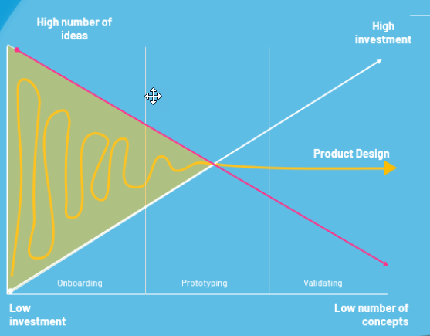
Successful innovation looks like failing 9 out of every 10 ideas at each stage-gate”​
-Alex Osterwalder - ​
Founder, Strategyzer​

Slide 27
IMPLEMENTATION

Slide 28
HOME OF CREATORS

Slide 29

THE TRUTH IS…
Walmart Creator is only a small piece of the creator jigsaw

Slide 30

CREATOR SOLUTIONS
Product Sales
Service Innovation
Influencer Marketing
Creator Growth Incubator
Product Innovation
Creator Management Tools

Slide 31
SMALL CREATOR - BIG RESPONSIBILITY
Creator Roles
Idea generation
A-Z content production
Promotion
Content strategy
Growth strategy
Community building

Slide 32
SMALL CREATOR - BIG RESPONSIBILITY
Creator Roles
Entrepreneur Roles
Idea generation
Monetization
A-Z content production
Collaboration with brands
Promotion
Brand Building
Content strategy
Communication
Growth strategy
Community building

Slide 33


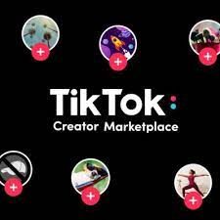



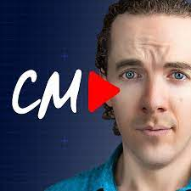


CREATORS ARE BOMBARDED

Slide 34
HOME OF CREATORS
A one-stop platform for creators, helping them get noticed, monetized and maintain a stable business, while focusing on what they truly enjoy - creating content

Slide 35
SMALL CREATOR - BIG RESPONSIBILITY
How to help creators focus on creation?

Slide 36
ADRESSING PROBLEMS OF CREATORS OF ALL SIZES
1M+
500k - 1M
50k-500k
<10k
10k-50k

Slide 37
HOME OF CREATORS FEATURES
Product Production
Platform for selling merch
Coaching Program
Business Consultation
Multi-platform analytics
Conferences
Trend Alerts
Creator Agency - Connecting creators with brands
Walmart Creator Included
Key Customers - Nano to Macro creators

Slide 38
CREATOR SOLUTIONS
Product Sales
Service Innovation
Influencer Marketing
Creator Growth Incubator
Product Innovation
Creator Management Tools

Slide 39
THE FEAR OF BECOMING OBSOLETE
Imagine depending on popularity and AI Algorithms for future growth

Slide 40
MEGA CREATORS AREN’T LEFT OUT
PROBLEM
SOLUTION
Home of Creators podcast
Creators feel unstable
Providing financial safety for 1M+ followers creators included as mentors
Even after creators lose popularity, they can work for Home of Creators

Slide 41
BLUE LABS OBJECTIVES
IMPROVE CUSTOMER NPS
?
GENERATE ALTERNATIVE REVENUE STREAMS
REDUCE COST TRANSFORMATION
LEAD DISRUPTIVE AND RADICAL INNOVATION

Slide 42
WALMART WONDERLAND

Slide 43
WALMART WONDERLAND
Specialized and themed attractions related to Walmart departments
Vancouver - central, good weather, domestic tourist location
Content creator world providing support, a set and visuals
Can be paid by Walmart Loyalty program points if desired
Creating a live and fun Walmart interactive experience

Slide 44
WALMART WONDERLAND
SPORTS
TECH
FOOD
BOOKS
CONTENT CREATORS
BEAUTY
HOME
FASHION AND BEAUTY

Slide 45
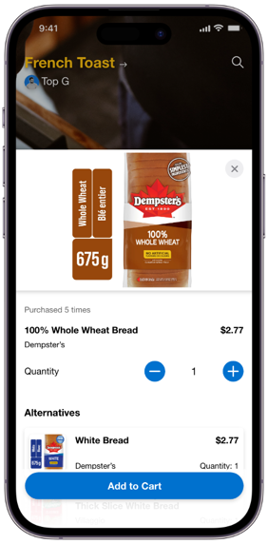
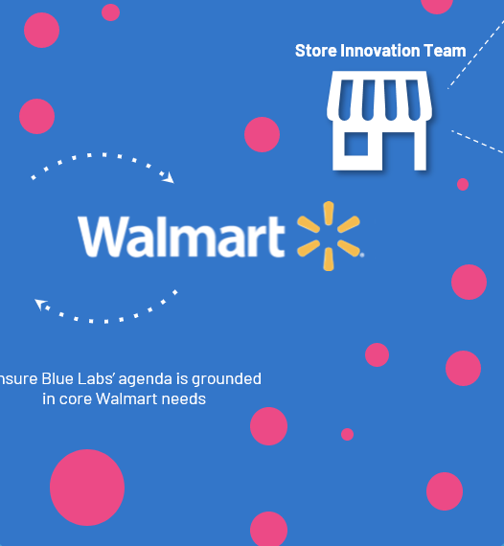
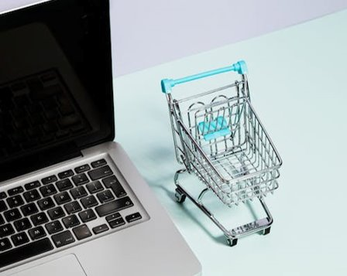
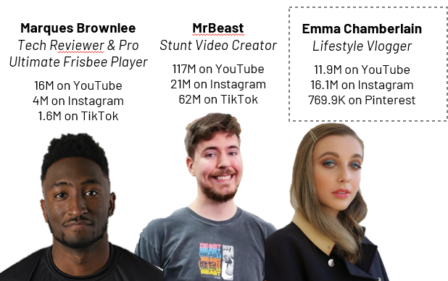
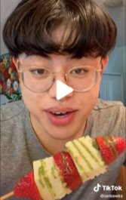
THE NEXT STOP WALMART WONDERLAND
Shop your clothes
Scan your products
Get what you scan at the end of your day!
Meet your favorite influencers
Enjoy the amusement park, eat food sold at Walmart
Be an influencer for one day

Slide 46
DISNEYLAND
Walmart can become the next Alibaba in Canada and North America
Use Alibaba wholesale model by selling large quantities in low prices

Slide 47
A PROVEN MODEL
Disney
Disney’s Amusement Parks is it’s 2nD largest revenue stream
Halo effect - all parts of the Disney’s business integrate within the parks
Multiple global scale-up opportunities
Capitalizes on Disney’s products (characters)

Slide 48
CREATING TOMORROW’S RETAIL EXPERIENCE - ATTRACTIONS
Rides are decorated as per department
Waiting lines and exit are part of a store
Customers scan their items and receive products later
Entertainment and music made by those in ‘Home of Creators’
1
2
3
4

Slide 49
CREATING TOMORROW’S RETAIL EXPERIENCE - ATTRACTIONS
ENTRY
EXIT
1
3
2

Slide 50
CREATING TOMORROW’S RETAIL EXPERIENCE - ATTRACTIONS
ENTRY
EXIT
1
3
Physical products and screens showing popular products of that category
Customers use their phone on the park’s app to scan products they want, adding to their cart
Items are to be picked up at the Walmart Wonderland Exit (run by Walmart employees)

Slide 51
CREATING TOMORROW’S RETAIL EXPERIENCE - ATTRACTIONS
Basketball hoop
Wave
2

Slide 52
USING WALMART’S SCALE AND SCOPE
Workforce
Supply Chain
Financial Capability
Uses Walmart’s teams for implementation
Walmart-only employees run park
Easy to provide park and store needs
Strong partnerships (ability to outsource)
Able to invest large sum of money into Walmart Wonderland
1
2
3

Slide 53
PROMISE TO REGENERATE
HOW DO WE REGENERATE
1
Recycled water throughout park, recycling bins provided
Alliance to protecting our environment
2
Receipts to be received by park app
3
Park to be built from recycled materials, green building: eco-friendly
4
Part of revenue goes to conversation parks

Slide 54
WALMART ‘HOME OF CREATORS’ WORLD
Access to Creator Set Onsite with all tech and equipment, other support if need be
Provides exclusive places to film (all exclusive access to all Wonderworld locations)
Ability to provide entertainment throughout out via shows, music in attractions, art
Marketing opportunities for them and Walmart
Highest performing content creators will have their products as part of the world’s store

Slide 55
MARKETING OPPORTUNITiES
Live-streaming of behind the scenes of their content creation, attractions
Creating promos for upcoming attractions
Promoting their product as seen/used throughout
Partnerships with other + Creator for a day program
1
2
3
4

Slide 56
CREATOR FOR A DAY
Allowing general to take part in content creation for a day, enter a raffle to win when they buy tickets in advance
Content creators provide ideas, support and take part in creating with them
Interactive, meaningful and unique experience
Create account in ‘Home of Creators’ which they can keep building

Slide 57
BLUE LABS OBJECTIVES
IMPROVE CUSTOMER NPS
?
GENERATE ALTERNATIVE REVENUE STREAMS
REDUCE COST TRANSFORMATION
LEAD DISRUPTIVE AND RADICAL INNOVATION

Slide 58
ADDITIONAL REVENUE STREAMS
Walmart as a wholesale
Supply Chain as a service
1
2

Slide 59
ADDITIONAL REVENUE STREAMS
Walmart as a wholesale
Use the size, expertise and power of Walmart to be the next leading figure in the wholesale industry
Wholesale marketplace for buyers looking to purchase large quantities of products at the lowest price
Walmart will become a wholesaler for other companies
The customers will pay for the service based on their needs
?
$
Purpose
People
Action
Cost

Slide 60
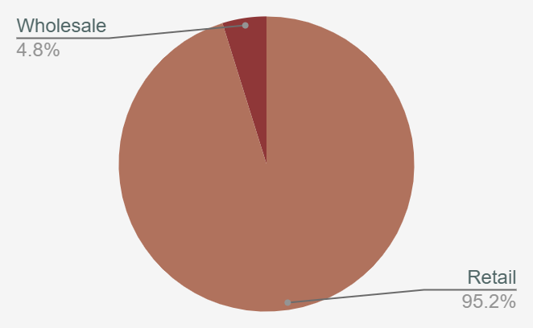
ALIBABA RETAIL VS WHOLESALE
Use Alibaba wholesale model by selling large quantities in low prices
Walmart can become the next Alibaba in Canada and North America
Model and Implement

Slide 61
ADDITIONAL REVENUE STREAMS
Supply chain as a service
The “Power of Walmart” can be utilized to support in the viability and implementation of innovation solution
Business with partial products that needs Walmart supply chain
Full service that includes :
delivery, storage, returns and other logistics
The customers will pay for the service based on their needs
?
$
Purpose
People
Action
Cost

Slide 62
IMPLEMENTATION TIMELINE
PRIORITIZE AND CONDUCT RESEARCH
GAIN BOARD SUPPORT
FINISH IMPLEMENTATION PLAN
IDEATION STAGE
FINALIZE CUSTOMER FEEDBACK
2023
JAN
FEB
MAR
APR
MAY
JUN
JUL
AUG
SEP
OCT
NOV
DEC
2024
JAN
FEB
MAR
APR
MAY
JUN
JUL
AUG
SEP
OCT
NOV
DEC
HOME OF CREATORS PROTOTYPE LAUNCHED
FOCUS GROUPS
FINISH BUILDING WONDERLAND

Slide 63
BLUE LABS OBJECTIVES
IMPROVE CUSTOMER NPS
?
GENERATE ALTERNATIVE REVENUE STREAMS
REDUCE COST TRANSFORMATION
LEAD DISRUPTIVE AND RADICAL INNOVATION

Slide 64
RISK MITIGATION & SUMMARY

Slide 65
RISK MITIGATION
RISK
MITIGATION
Home of cerators
Creators will not use the service
Collaboration with Mr. Beast to attract the audience + Capitalize on relationships
1
Walmart Wonderland
Big competition with DIsney and Universal Studios
Use the influencers to attract clients, get feedback and improve based on customers needs
2
Time to market
Implementation plan may take time
Use Walmart strength, power and experience + First in the market
3

Slide 66
KEY ISSUES
How can Blue Labs shape the retail experience of tomorrow ?
Size & Scale
Current infrastrastructure
Revenue Streams
Trends
Involving creator commerce and alternatives

Slide 67
“ If you are not uncomfortable you are not doing it right”
Blue labs team

Slide 68
QUESTIONS AND ANSWERS
Analysis & Alternatives
Recommendations
Implementation
Financial Analysis

