Slide 1

The future of AI in Society
181
CONSULTING
Presenting to: the Government of Canada
Bobby Currie | Chelsea Kokan
Jordi Johnson | Laura Effinger

Slide 2
Executive Summary
Sentient AI is uncharted territory
Businesses and consumers have some opposed interests
Human privacy and autonomy is at risk
Challenges
Establish a universal standard for the integration of AI into society
Key Objective
Enable societal growth
Protect society interests
Ensure ethical development
Goals
Notes:
Swap goals and challenges depending on company position, start with challenges if company is struggling

Slide 3
Our Strategy
Enable the advancement of society by integrating AI in the role of collaborator
1
2
Leverage AI to create a vibrant economy
Educate the population and encourage economic growth
Employ government oversight for societal protection
Ensure that the role of AI is collaborative while accountability rests with humans

Slide 4
AI is Moving Forward but Integration of Regulation is Missing
Where is AI Headed
Table stakes AI
AI Now
Analytical, non-sentient
Introduction of sentience
Sentient
Widely integrated into businesses
Evaluative, accurate communication
Businesses are looking to capitalize on sentience, but a lack of structure imposes threats (bias, loss of control, ethics, weaponization etc.)
As AI evolves, regulations need to be developed to ensure a consistent path forward

Slide 5
The Human Touch Remains a Key Aspect
AI Sentience Applications
Human Input
ChatGPT/LaMDA
Results are unvetted
Judge and application of information needs human evaluation
Melanoma Diagnosis
High stakes results that need confirmation
Doctors are required to verify information and deliver message
Sales & customer service optimization
Collects and responds
A human needs to be evaluate data and act as support
Human collaboration is required to ensure AI is used as efficiently as possible

Slide 6
A Path Forward Needs to Consider Key Opportunities and Challenges
Key Stakeholder Opportunities and Challenges
Opportunities
Challenges
Customers
Improved CX/CS/Outcomes
Data Privacy
Employees
Increased Engagement
(less non-value added tasks)
Displacement
Shareholders
Reputational Risks
(see above)
Increased Profitability
Business Leadership
Change Management &
Lack of AI labor
Increased Efficiency

Slide 7



Finding a Solution to Drive Success
Alternatives
AI as a Decision Maker
AI as an Advisor
AI as a Collaborator
AI as primary trusted decision maker
AI provides input that requires oversight
AI tasks with human accountability

Slide 8




Solution for a Successful Path Forward
Alternatives & Evaluation
Ethicality
Efficiency
Economic Growth
AI as a Decision Maker
AI as an Advisor
AI as a Collaborator

Slide 9
Solution for a Successful Path Forward
Alternatives & Evaluation
Ethicality
Efficiency
Economic Growth
AI as a Decision Maker
AI as an Advisor
AI as a Collaborator

Slide 10
Our Strategy
Enable the advancement of society by integrating AI in the role of collaborator
1
2
Leverage AI to create a vibrant economy
Educate the population and encourage economic growth
Employ government oversight for societal protection
Ensure that the role of AI is collaborative while accountability rests with humans

Slide 11
Existing business model
Recommendation
Business
Public awareness
AI integration
Data collection
Unregulated use

Slide 12
Integration of specific oversight and accountability brings the public in
Recommendation
Business
Accountability
Government oversight
Public awareness
AI integration
Data collection
Regulated use

Slide 13
1
Leverage AI to create a vibrant economy
WHAT
Create a retraining program
Introduce population education on AI
WHY
Allow businesses to develop AI capabilities to grow their economic impact
Mitigate the impact of shifting labor requirements
IMPACT
Reposition labor force
Deepen societal understanding

Slide 14
Investment justification
Implementation
1
Leveraging AI to create a vibrant economy
Retraining Program
Business Council
Guidance and Placement
AI displacement tax
5% of displaced wages
Education Centres & EI Support
University partnerships
Economic stability and boost to strategic labour markets

Slide 15
Investment justification
Implementation
1
Leveraging AI to create a vibrant economy
Education Program
Personalized Learning
K-9 exposure
Vocational Streams
Guidance and Placement
Savvy workforce for ongoing economic development

Slide 16
2
Employ government oversight for societal protection
WHAT
Introduce an AI use certification program
Decision making accountability remains with humans
WHY
Enable oversight of the use for AI within businesses to ensure the collaborative role is maintained
Displaced workers are re-employed
Human decision making is better informed
Human society retains decision making control
IMPACT

Slide 17
Investment justification
Implementation
2
Introduce an AI use certification program
Ethical AI Certification
Legal Framework for Human Accountability
Data privacy
Bias management
Social benefit
Legal accountability for AI decisions
Encourages collaboration
Businesses
Even playing field
Public buy in
Society
Protection from harm
Support collaboration

Slide 18


Global Connections
Partners
GLOBAL FRAMEWORK
Prevents offshoring | Consistent experience |

Slide 19
Timeline
Implementation Timeline
Year 1
Year 2
Year 3
Year 4
Year 5
Q1
Q2
Q3
Q4
Q1
Q2
Q3
Q4
Q1
Q2
Q3
Q4
Q1
Q2
Q3
Q4
Q1
Q2
Q3
Q4
AI displacement tax
Business Council
Retraining Program Dev
Education Centres
Refresh
Personalized Learning RFP
Personalized Learning
Vocational Streams
Legal Framework
International Partnerships

Slide 20
Government Interventions
Expenses
AI Displacement Tax
Retraining Program
Extended EI
Jobs Directly Displaced by AI:
5% tax for displaced wages for 2 years
Jobs Directly Displaced by AI:
Government / Business 50/50 Split
Average Cost $10k per EE
Jobs Directly Displaced by AI:
Extend by 5 Weeks
Average Cost $10k per EE

Slide 21
Government Supports
Expenses
Educational Program
AI Integration
Modify Curriculum:
K-12
$50M Creation
$100M Supports/Province
Estimated $800M Initial Investment
10 year project
Ongoing $250M

Slide 22
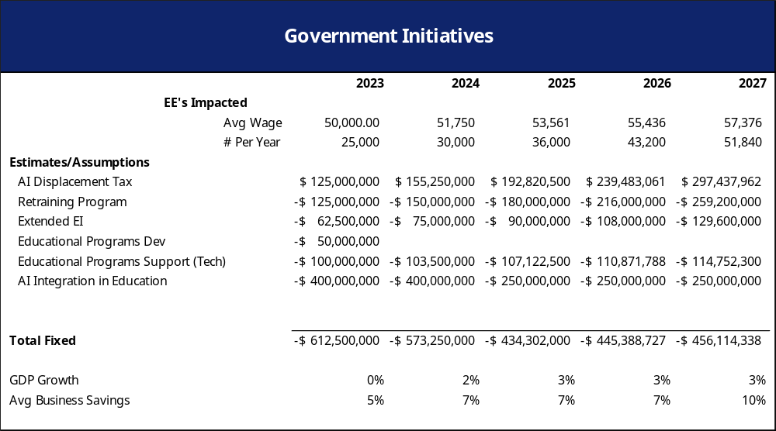

Slide 23


KPI’s for Success
Measure and Control
Business Health
Economic Health
Employee’s Supported
Avg EBITDA Growth >5%
Incremental GDP Growth of 0.20%
.
Target of 186K in 5 years
.

Slide 24
Risk Mitigation for Success
Identified Risks & Mitigation
High
Risks
Mitigation
Resistant global partners
Leverage trade agreements
1
1
Impact
Public perception of AI domination
Publicize AI certification overviews for public review
2
2
3
Industry regulation resistance
Education programs to show how these regulations are protecting the economy
3
Probability
Low
High

Slide 25
Conclusion
Key Objective
Establish a universal standard for the integration of AI into society
Enable the advancement of society by integrating AI in the role of collaborator
Strategy
Leverage AI to create a vibrant economy .
Employ government oversight for societal protection
Components
Public trust in industry AI use
186K retrained and supported workers
Impact

Slide 26

Thank you
181
CONSULTING

Slide 27
Society
Government
Businesses
Employees
Citizens

