Slide 1
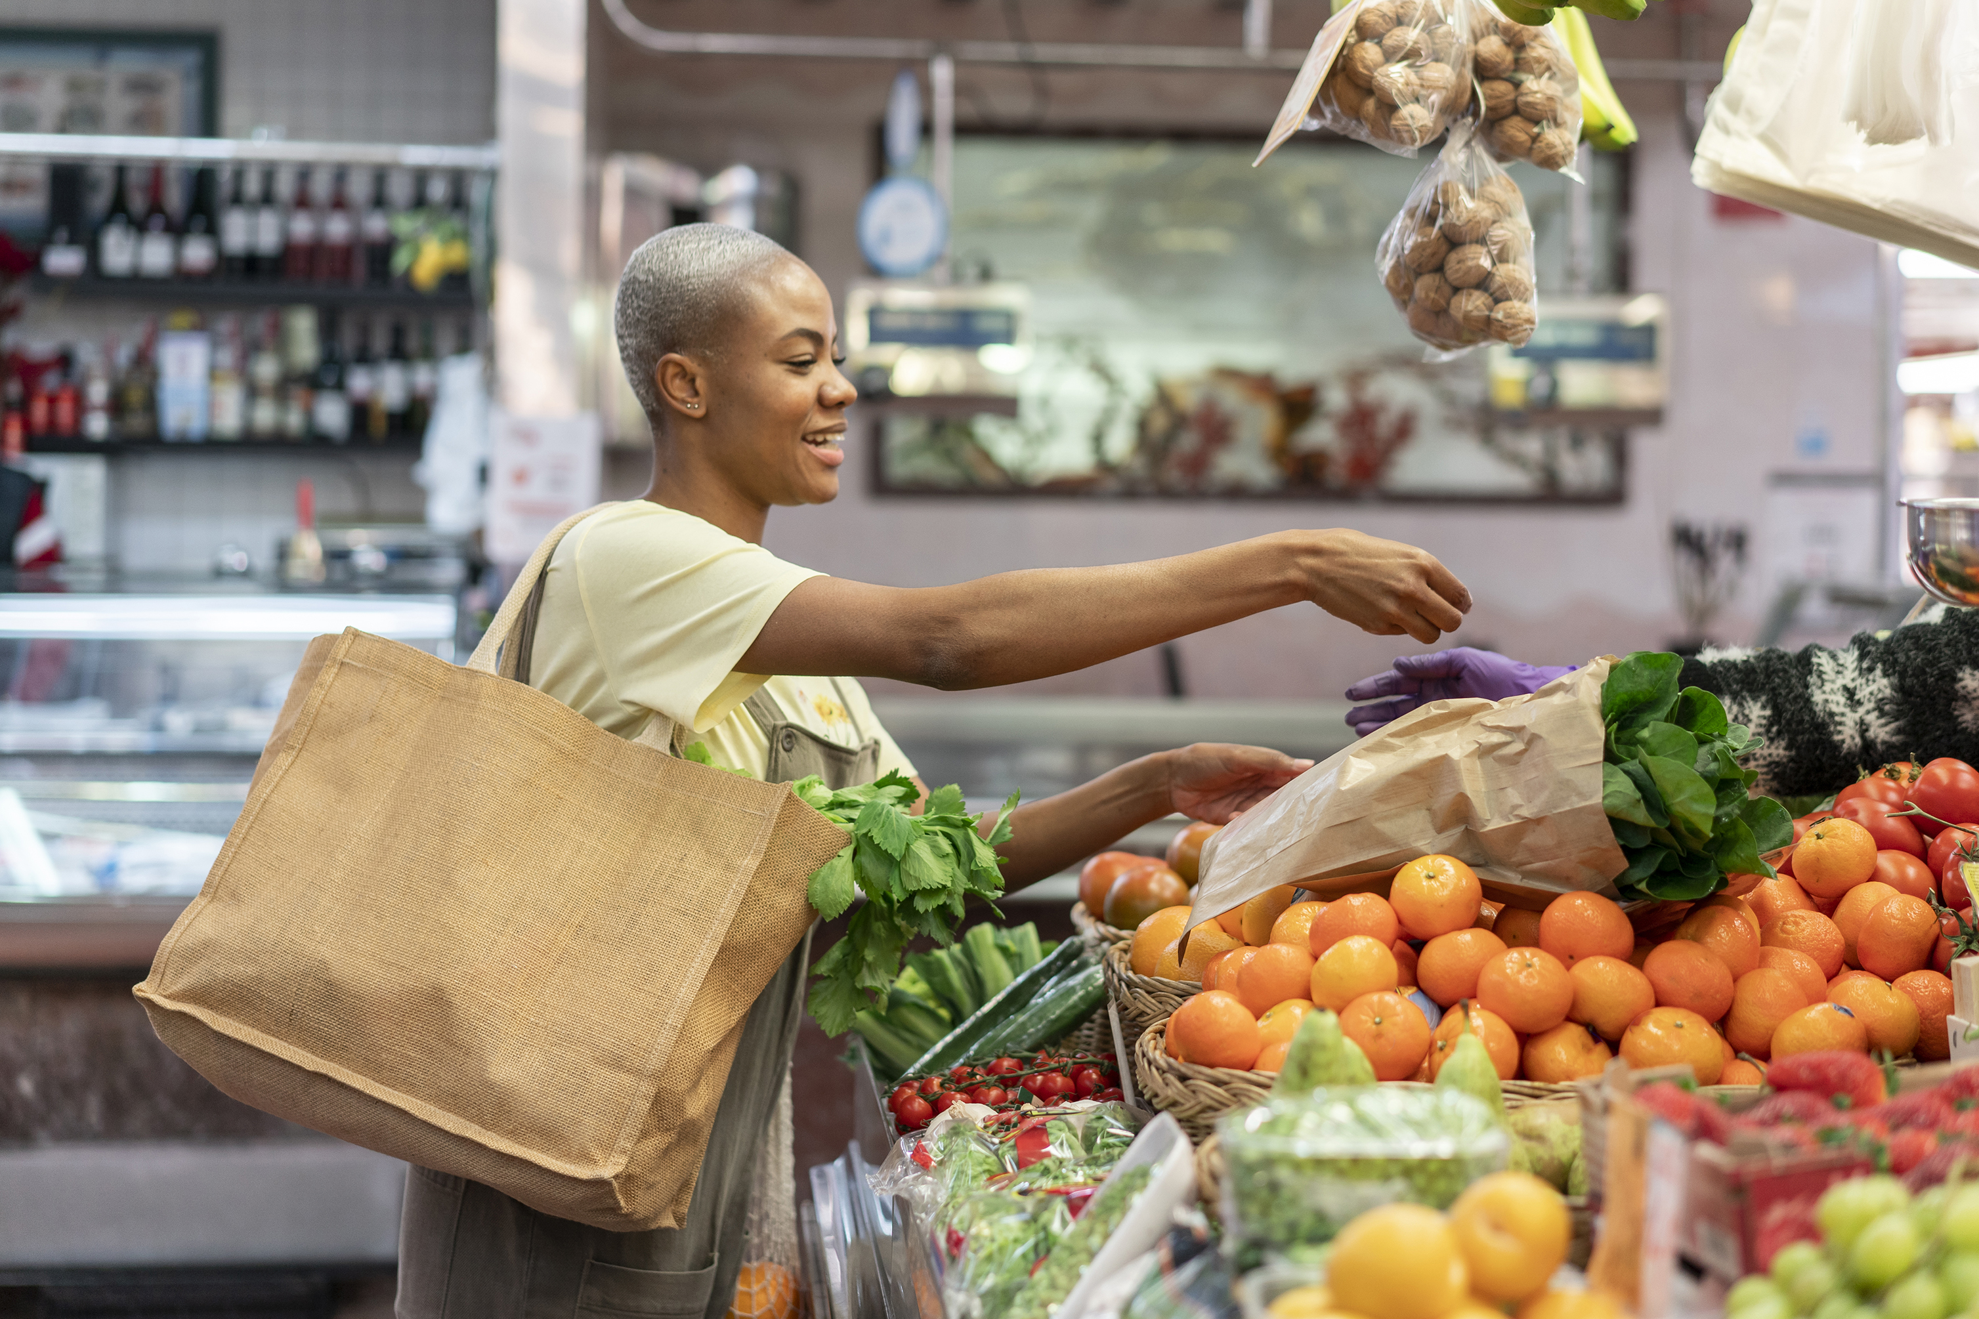


Building Sustainable Growth with Instacart

Slide 2
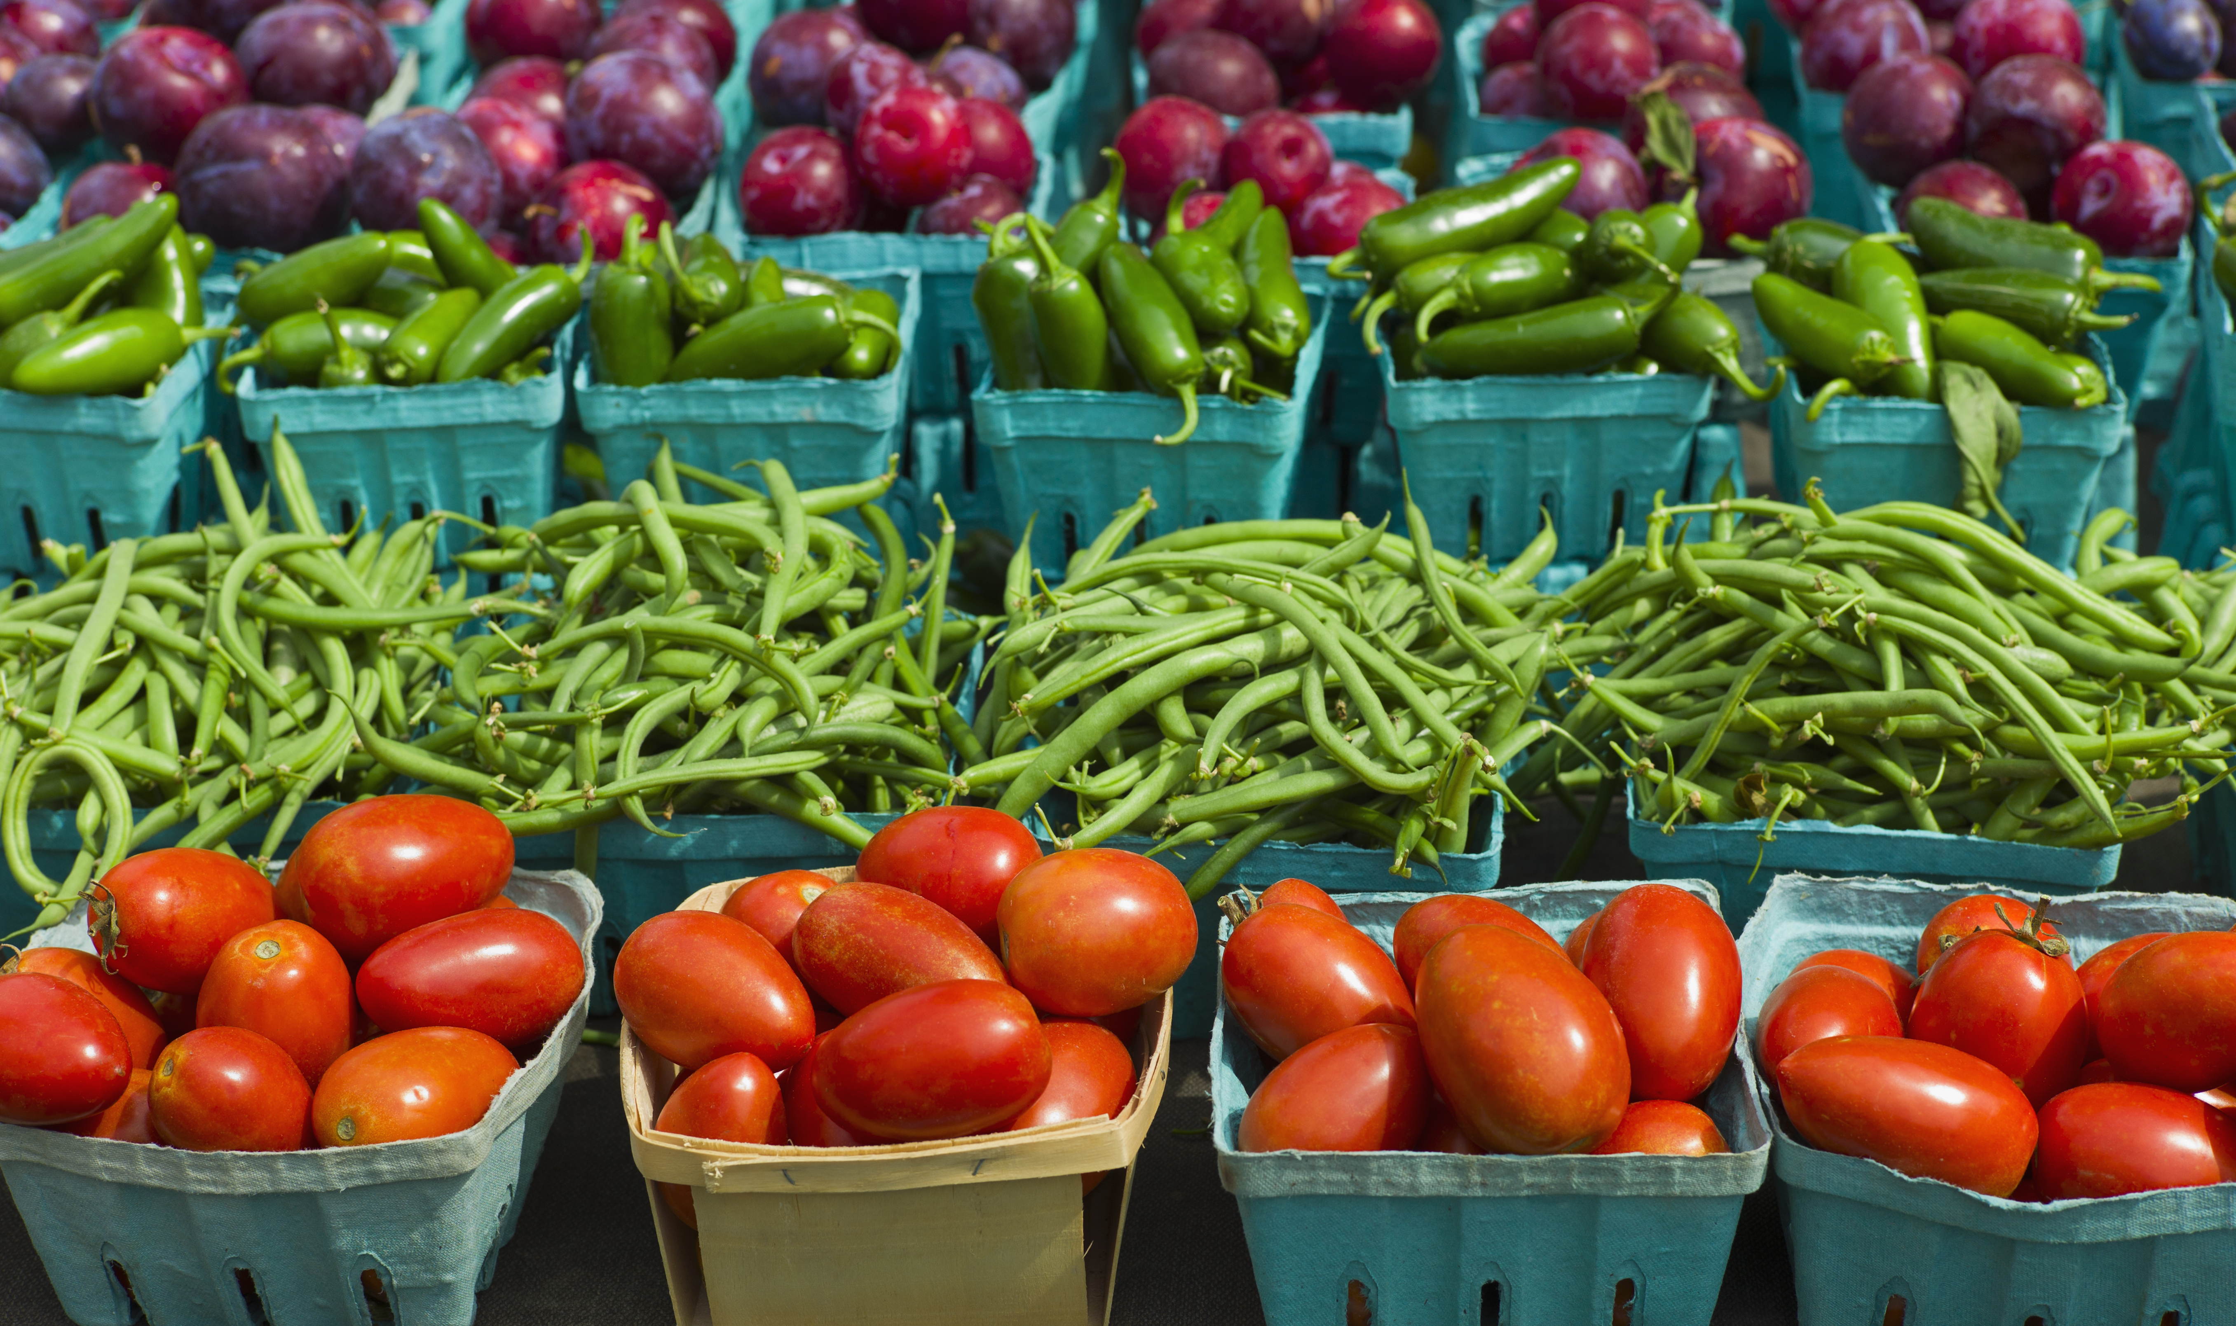
To build a world where everyone has access to the food they love and more time to enjoy it together.

Slide 3
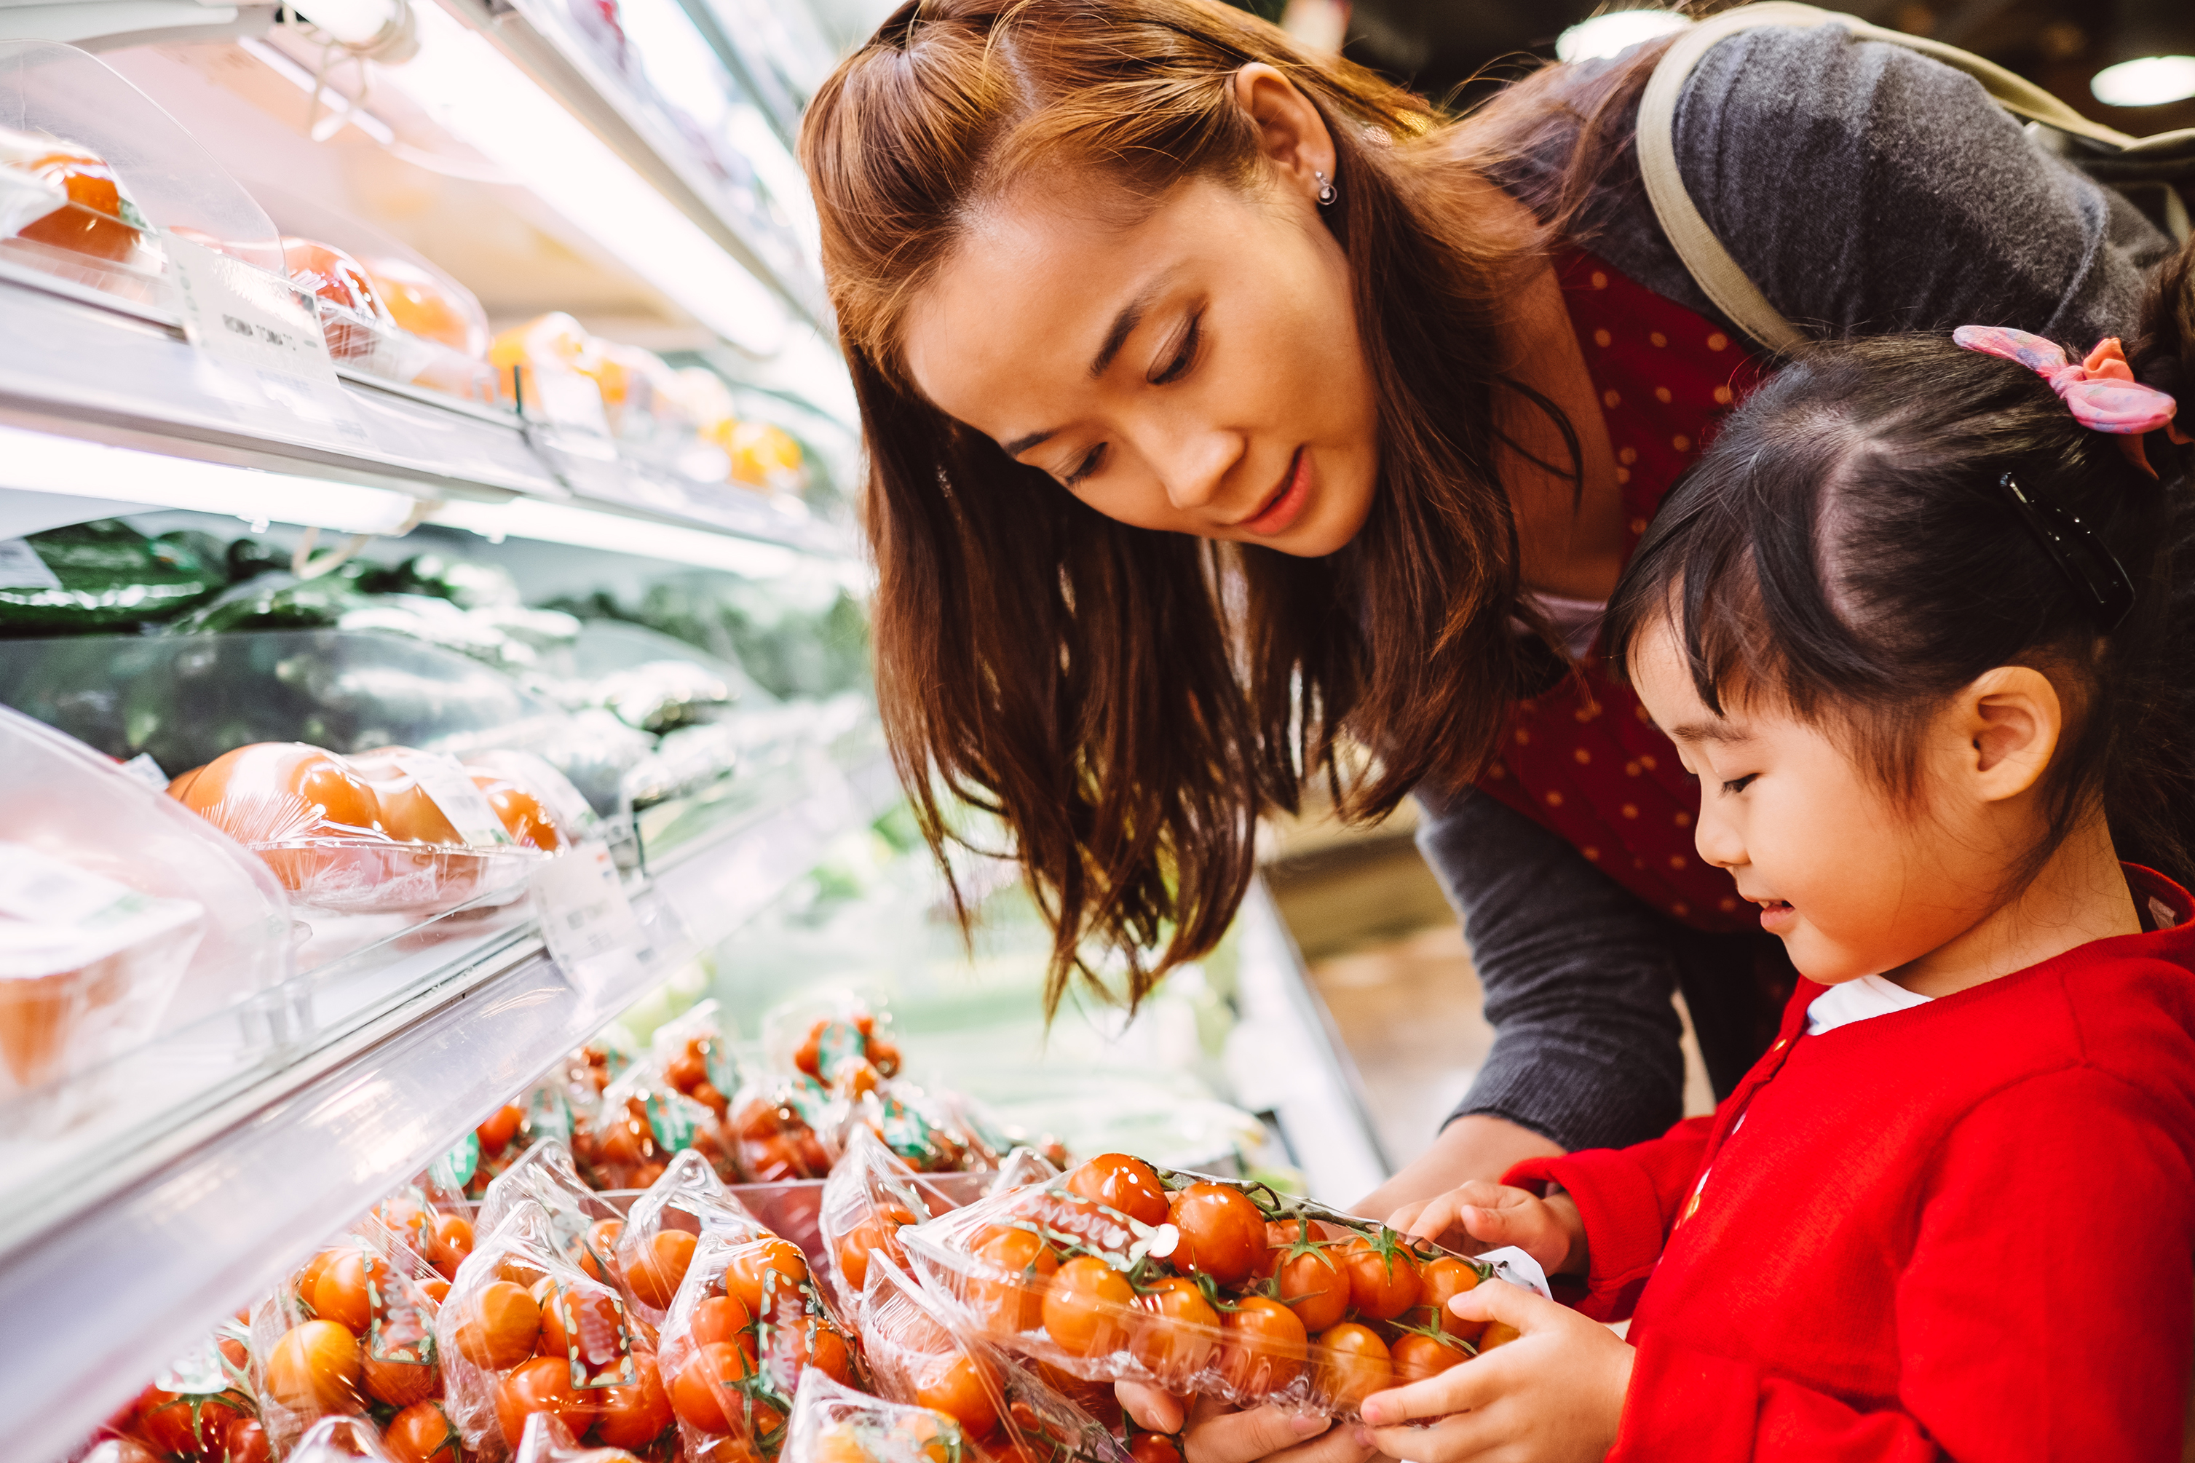
Introducing Naomi
A 33-year-old mother
Loves being in the kitchen with her daughter exploring new recipes
Avid social media user and follows many celebrity chefs and food blogs
Overwhelmed by the number of recipes she has saved and needing to search for ingredients
Loves to share her own food content

Slide 4
Instacart has revolutionized the way customers interact with food.
How can we continue to maintain this strong growth and ensure a sustainable future in the long term?

Slide 5





Chirag Sheth
Stephanie Keen
Brandon Kober
Sejal Pandya

Slide 6

Introducing Insta-Recipe
A data-driven, shared value experience, to help shoppers experience a hub of new products and recipes
Insta-Recipe

Slide 7
Key Issues

Slide 8


Key Issues
- Importance +
 | - Urgency +
Supermarket Relations
Building a mutually beneficial environment of trust with supermarkets
Introduction
Key Issues
Analysis
Opportunities
Solution
Implementation
Risks

Slide 9


Key Issues
- Importance +
 | - Urgency +
Supermarket Relations
Building a mutually beneficial environment of trust with supermarkets
Competition
Competitive advantage with retailers such as Amazon, Walmart, etc.
Introduction
Key Issues
Analysis
Opportunities
Solution
Implementation
Risks

Slide 10


Key Issues
- Importance +
 | - Urgency +
Supermarket Relations
Building a mutually beneficial environment of trust with supermarkets
Competition
Competitive advantage with retailers such as Amazon, Walmart, etc.
Long-Term Sustainability
Ensuring growth rates experienced during pandemic are sustained
Introduction
Key Issues
Analysis
Opportunities
Solution
Implementation
Risks

Slide 11


Key Issues
- Importance +
 | - Urgency +
Supermarket Relations
Building a mutually beneficial environment of trust with supermarkets
Competition
Competitive advantage with retailers such as Amazon, Walmart, etc.
Long-Term Sustainability
Ensuring growth rates experienced during pandemic are sustained
Gig Workers & Unions
Classification and support of gig workers due to recent litigation
Introduction
Key Issues
Analysis
Opportunities
Solution
Implementation
Risks

Slide 12
Analysis

Slide 13
Instacart Business Model
Customer Segments
Users
Who want grocery products at their doorstep
People who don’t have time to shop themselves
Shoppers
People who want to work as freelance shoppers
People who have a car and smartphone
Stores
Who want to enhance business growth
Who want to reach more people
Key Resources
Partnership with local stores
Skillful shoppers
New and advanced technology
Value Proposition
Tie-ups with local stores and supermarkets
Hiring part-time and full-time workers
Same-day delivery process
No delivery trucks, no warehouses
Cost Structure
Technological setup cost
Salaries
Promotional cost (advertisements)
Key Activities
Creating an effective technological infrastructure
Dealing with market partners
Managing the shopper (delivery partner) workforce
Provided food delivery to customer
24/7 customer service
Key Partners
Local Stores (Wegmans, Krogers, 7-Eleven, Costco, etc)
Revenue Stream
Delivery Fee
Membership fee
Promotional offers
Mark up prices
Channels
Website
Mobile app for iOS and Android
Customer Relationships
Customer services
Social Media
Source: MobiSoft, and Instacart Case, 2021
Introduction
Key Issues
Analysis
Opportunities
Solution
Implementation
Risks

Slide 14
Instacart Business Model
Customer Segments
Users
Who want grocery products at their doorstep
People who don’t have time to shop themselves
Shoppers
People who want to work as freelance shoppers
People who have a car and smartphone
Stores
Who want to enhance business growth
Who want to reach more people
Key Resources
Partnership with local stores
Skillful shoppers
New and advanced technology
Value Proposition
Tie-ups with local stores and supermarkets
Hiring part-time and full-time workers
Same-day delivery process
No delivery trucks, no warehouses
Cost Structure
Technological setup cost
Salaries
Promotional cost (advertisements)
Key Activities
Creating an effective technological infrastructure
Dealing with market partners
Managing the shopper (delivery partner) workforce
Provided food delivery to customer
24/7 customer service
Key Partners
Local Stores (Wegmans, Krogers, 7-Eleven, Costco, etc)
Revenue Stream
Delivery Fee
Membership fee
Promotional offers
Mark up prices
Channels
Website
Mobile app for iOS and Android
Customer Relationships
Customer services
Social Media
Source: MobiSoft, and Instacart Case, 2021
Key Takeaway: Instacart has a combined business model that helps brick-and-mortar grocers be successful online
Introduction
Key Issues
Analysis
Opportunities
Solution
Implementation
Risks

Slide 15
Grocery E-commerce on the rise
Grocery sales jumped 300% in early 2020
Shopping for groceries is a $1trillion business in the U.S.
Gen-Z and Millennials are the driving forces
Strengthening Customer Relationships through customization and loyalty programs
Source: Forbes, 2021
Introduction
Key Issues
Analysis
Opportunities
Solution
Implementation
Risks

Slide 16
Grocery E-commerce on the rise
Grocery sales jumped 300% in early 2020
Shopping for groceries is a $1trillion business in the U.S.
Gen-Z and Millennials are the driving forces
Strengthening Customer Relationships through customization and loyalty programs
Source: Forbes, 2021
Key Takeaway: Grocery e-commerce sales will continue to see rapid growth
Introduction
Key Issues
Analysis
Opportunities
Solution
Implementation
Risks

Slide 17
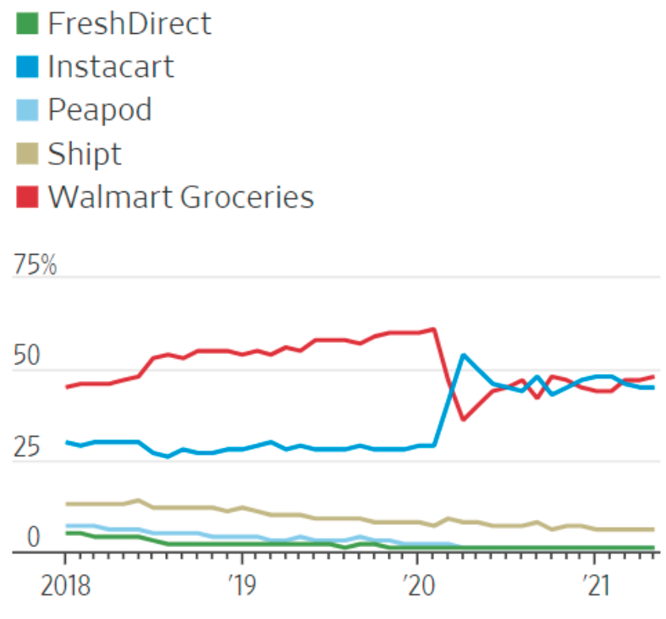
Grocery E-Commerce Market Share
Market Share of Some Popular Grocery Delivery Companies
Between March 2020 and April 2020, total sales grew by 62%
While demand for grocery delivery still exceeds pre-pandemic levels, sales have been gradually declining in 2021
Instacart and Walmart Grocery continue to be leader in the grocery delivery space
Walmart Grocery holds 48% of sales, and Instacart holds 45% of sales
Source: Instacart Case, 2021
Introduction
Key Issues
Analysis
Opportunities
Solution
Implementation
Risks

Slide 18
Grocery E-Commerce Market Share
Market Share of Some Popular Grocery Delivery Companies
Between March 2020 and April 2020, total sales grew by 62%
While demand for grocery delivery still exceeds pre-pandemic levels, sales have been gradually declining in 2021
Instacart and Walmart Grocery continue to be leader in the grocery delivery space
Walmart Grocery holds 48% of sales, and Instacart holds 45% of sales
Source: Instacart Case, 2021
Key Takeaway: While Instacart became extremely successful as a result of the pandemic, it now faces significant competition and must find ways to continue to stay competitive.
Introduction
Key Issues
Analysis
Opportunities
Solution
Implementation
Risks

Slide 19
Opportunities

Slide 20


Potential Solutions
Insta-Recipe
Restaurant Suppliers
Government (Food Security)
Introduction
Key Issues
Analysis
Opportunities
Solution
Implementation
Risks

Slide 21
Solutions
Insta-Recipe
A data-driven, shared value experience, to help shoppers experience a hub of new products and recipes
Introduction
Key Issues
Analysis
Opportunities
Solution
Implementation
Risks

Slide 22
Pros
Cons
Long-term growth potential
Dependent on external factors
May increase costs
Solutions
Insta-Recipe
A data-driven, shared value experience, to help shoppers experience a hub of new products and recipes
Increases efficiency, reduces shopping time
Introduce customers to new products and recipes
Introduction
Key Issues
Analysis
Opportunities
Solution
Implementation
Risks

Slide 23

Solutions
Restaurant Suppliers
Instacart’s platform would be used by restaurants chefs and staff to stock ingredients
Introduction
Key Issues
Analysis
Opportunities
Solution
Implementation
Risks

Slide 24
Pros
Cons
Easy ordering service
Produce, meats, and other ingredients would be delivered directly to the restaurant
Time and energy efficient service
“First-mover advantage”
Solutions
Restaurant Suppliers
Instacart’s platform would be used by restaurants chefs and staff to stock ingredients
Limited to specific suppliers only
High competition: Sysco
Does not address key issue of gig workers and unions
Introduction
Key Issues
Analysis
Opportunities
Solution
Implementation
Risks

Slide 25

Solutions
Government (Food Security)
Instacart would provide services to those individual who may not have access to extensive grocery options (i.e those living in rural areas) at a lower cost through government subsidies
Introduction
Key Issues
Analysis
Opportunities
Solution
Implementation
Risks

Slide 26
Pros
Cons
Solutions
Government (Food Security)
Instacart would provide services to those individual who may not have access to extensive grocery options (i.e those living in rural areas) at a lower cost through government subsidies
Long-term
Government Lobbying
Reliance on having access to mobile phones/internet
Create food security
Increase grocery access in rural areas
Support gig workers and unions
Introduction
Key Issues
Analysis
Opportunities
Solution
Implementation
Risks

Slide 27

Decision Matrix
Factor | Weight |  | Restaurant Suppliers | Government (Food Security)
Gig Workers and Unions | 0.1 | 1 | 1 | 4
Supermarket Relations | 0.35 | 4 | 3 | 2
Competition | 0.2 | 5 | 3 | 2
Long-term Growth | 0.35 | 4 | 3 | 4
Total | 1.0 | 3.9 | 2.8 | 2.9
Scale out of 5
Introduction
Key Issues
Analysis
Opportunities
Solution
Implementation
Risks

Slide 28
Decision Matrix
Factor | Weight |  | Restaurant Suppliers | Government (Food Security)
Gig Workers and Unions | 0.1 | 1 | 1 | 4
Supermarket Relations | 0.35 | 4 | 3 | 2
Competition | 0.2 | 4 | 3 | 2
Long-term Growth | 0.35 | 5 | 3 | 4
Total | 1.0 | 3.9 | 2.8 | 2.9
Scale out of 5
Introduction
Key Issues
Analysis
Opportunities
Solution
Implementation
Risks

Slide 29

Recommendation
Insta-Recipe

Slide 30


Claire Saffitz
I am a dessert person
Recipe: Chocolate Eclairs/Pâte à Choux
A data driven shared-value experience to shop recipes
Hub of recipes, chefs, users and products where the ingredients can be purchased and delivered on demand
Ingredient generator for linked recipes
4-sided benefit creation
Jump to Recipe
Order Ingredients through Insta-Recipe

Slide 31
Value generators:
Ad revenue
Larger order values
Meet customer demands
Improved relations

Slide 32
4-Sided Benefit
Gig workers
Retailers
Consumers
Brands
Diverse opportunities to engage
Receive data intensive reports to better meet customer demands
Increased user experience to shop recipes and streamline process
Advertising products in recipes and on platform
Higher compensation

Slide 33
Implementation

Slide 34
The EAT! Plan
Eat
(0-3months)
Accelerate
(3-6 months)
Transform
(6 months +)
Build the ML algorithms
Build partnerships with chefs and consumer goods
Launch Insta-Recipe with sponsored chefs, products
Demonstrate shared value with retailers, suppliers, and consumers
Open access network of Insta-Recipe influencers, and users
Introduction
Key Issues
Analysis
Opportunities
Solution
Implementation
Risks

Slide 35
Establish – A - T
Timeline
Establish (0-3 months)
Machine Learning
Website & App
Partners
Accelerate (3-6 months)
Transform (6 months +)
Introduction
Key Issues
Analysis
Opportunities
Solution
Implementation
Risks

Slide 36
Establish – A - T
Key Activities
Timeline
Build Machine Learning algorithms
  Turn written recipe content into tailored shopping
Build website and app functionality
  Video and recipe content hosting
  Integrate algorithms
Connect with partners for upcoming soft launch
  Celebrity chefs
  Consumer goods brands
Establish (0-3 months)
Machine Learning
Website & App
Partners
Accelerate (3-6 months)
Transform (6 months +)
Introduction
Key Issues
Analysis
Opportunities
Solution
Implementation
Risks

Slide 37
Establish – A - T
Key Activities
Timeline
Build Machine Learning algorithms
  Turn written recipe content into tailored shopping
Build website and app functionality
  Video and recipe content hosting
  Integrate algorithms
Connect with partners for upcoming soft launch
  Celebrity chefs
  Consumer goods brands
Establish (0-3 months)
Machine Learning
Website & App
Partners
Accelerate (3-6 months)
Transform (6 months +)
Key Success Factors
Algorithms & functionality developed on-time and on-budget
Agreements with 12 chefs and up to 60 brands
Introduction
Key Issues
Analysis
Opportunities
Solution
Implementation
Risks

Slide 38
E – Accelerate – T
Timeline
Establish (0-3 months)
Accelerate (3-6 months)
Soft Launch
Consumer Adoption
Transform (6 months +)
Introduction
Key Issues
Analysis
Opportunities
Solution
Implementation
Risks

Slide 39
E – Accelerate – T
Key Activities
Timeline
Soft Launch
  Celebrity chefs post 5 Insta-Recipes for 1 week, each with a different sponsored product
  Accessible on social media platforms, YouTube, and Instacart’s website
  Ability for direct recipe purchasing
Establish (0-3 months)
Accelerate (3-6 months)
Soft Launch
Consumer Adoption
Transform (6 months +)
Introduction
Key Issues
Analysis
Opportunities
Solution
Implementation
Risks

Slide 40
E – Accelerate – T
Key Activities
Timeline
Soft Launch
  Celebrity chefs post 5 Insta-Recipes for 1 week, each with a different sponsored product
  Accessible on social media platforms, YouTube, and Instacart’s website
  Ability for direct recipe purchasing
Establish (0-3 months)
Accelerate (3-6 months)
Soft Launch
Consumer Adoption
Transform (6 months +)
Key Success Factors
Social media sentiment analysis, views, clicks
Instacart website page views, visits
Consumer conversion rate: 2%
Introduction
Key Issues
Analysis
Opportunities
Solution
Implementation
Risks

Slide 41
E – A – Transform
Timeline
Establish (0-3 months)
Accelerate (3-6 months)
Transform (6 months +)
Increase manufacturing
Social media campaign
Introduction
Key Issues
Analysis
Opportunities
Solution
Implementation
Risks

Slide 42

E – A – Transform
Key Activities
Timeline
Hard Launch:
  Open access recipe repository on Instacart
    Influencer development & compensation
  Recipe-grocery generation service
  Ongoing evaluation & improvements
Establish (0-3 months)
Accelerate (3-6 months)
Transform (6 months +)
Increase manufacturing
Social media campaign
Introduction
Key Issues
Analysis
Opportunities
Solution
Implementation
Risks

Slide 43
E – A – Transform
Key Activities
Timeline
Hard Launch:
  Open access recipe repository on Instacart
    Influencer development & compensation
  Recipe-grocery generation service
  Ongoing evaluation & improvements
Establish (0-3 months)
Accelerate (3-6 months)
Transform (6 months +)
Increase manufacturing
Social media campaign
Key Success Factors
Goal: 300 recipes, 50 influencers by end of Year 1
  Recipe-grocery generation service increasingly used
Positive social media sentiment analysis
Introduction
Key Issues
Analysis
Opportunities
Solution
Implementation
Risks

Slide 44
Future State: Ecosystem of food content and access generating revenue for Instacart, retailers, gig workers, and consumer brands, with participation and insights from consumers
Enhanced algorithms to analyze consumer food trends, convert video content into ingredient lists, and provide data-driven strategies
Solidified and enhanced Instacart’s network of social media, consumer goods, food content networks

Slide 45
Future State: Ecosystem of food content and access generating revenue for Instacart, retailers, gig workers, and consumer brands, with participation and insights from consumers
Enhanced algorithms to analyze consumer food trends, convert video content into ingredient lists, and provide data-driven strategies
Solidified and enhanced Instacart’s network of social media, consumer goods, food content networks
Goal: Families and individuals share Insta-Recipe meals with access to the food they love and more time to enjoy it together and with others digitally.

Slide 46
Project Investment
 | Cost Over 1 Year
Machine Learning & Data Analytics | $120,000 *Based on Industry Averages
Marketing Expense (Sponsored Chefs) | $600,000 *((1 new chef a week x 12 weeks x 5 recipes = (10,000(fee) x 5(posts) x12 (weeks))
Commission for Influencers/Gig Workers | $5,000 *50 influencers at average cost of $100
Marketing Expense (Feature Rollout) | $25,000 *Based on Average Marketing Agency Pricing for Similar App Rollouts
Total Cost | $750,000
Introduction
Key Issues
Analysis
Opportunities
Solution
Implementation
Risks

Slide 47
Project Benefits
 | Additional Revenue Over 1 Year
Sponsored Products | $600,000 *($10,000 per sponsored product, 5 recipes, 12 weeks)
Larger Order Values (Increase by 5%) | $576,000 *$67 Average Weekly Grocery Bill * 5% Growth * 2% Customer Adoption (9.6M Total Users in 2020)
Total Revenue | $1,176,000
Introduction
Key Issues
Analysis
Opportunities
Solution
Implementation
Risks

Slide 48
Return on Investment
Total Cost | $750,000
Total Revenue | $1,176,000
ROI | 56.80%
Introduction
Key Issues
Analysis
Opportunities
Solution
Implementation
Risks

Slide 49
Risk and Contingency Strategies

Slide 50
Risks and Contingency Strategies
Risk | Likelihood | Impact | Trigger | Contingency
Low customer adoption | Low | Medium | 2% conversion rate from existing customers | Increase customer incentives such as offering the first free recipe
Introduction
Key Issues
Analysis
Opportunities
Solution
Implementation
Risks

Slide 51
Risks and Contingency Strategies
Risk | Likelihood | Impact | Trigger | Contingency
Low customer adoption | Low | Medium | 2% conversion rate from existing customers | Increase customer incentives such as offering the first free recipe
Gig worker compensation | High | Medium | Salary compensation for staff | Allocation from added advertising revenue to support gig workers
Introduction
Key Issues
Analysis
Opportunities
Solution
Implementation
Risks

Slide 52
Risks and Contingency Strategies
Risk | Likelihood | Impact | Trigger | Contingency
Low customer adoption | Low | Medium | 2% conversion rate from existing customers | Increase customer incentives such as offering the first free recipe
Gig worker compensation | High | Medium | Salary compensation for staff | Allocation from added advertising revenue to support gig workers
Low adoption from chefs and influencers to generate content | Low | Medium | Number of chefs and size of content library | Implement further co-branding opportunities
Introduction
Key Issues
Analysis
Opportunities
Solution
Implementation
Risks

Slide 53
Returning to Naomi
Naomi is now able to:
Find a new weekly recipe to make with her daughter
Is able to easily input a new recipe into the Instacart to quickly buy the ingredients she news
However most importantly…

Slide 54
To build a world where everyone has access to the food they love and more time to enjoy it together.

Slide 55
Hop on the cart to success with Insta-Recipe!

Slide 56
References
https://mobisoftinfotech.com/resources/blog/how-does-instacart-work-lets-take-a-deep-dive/
https://www.forbes.com/sites/chloesorvino/2021/01/27/instacart-survived-covid-chaos---but-can-it-keep-delivering-after-the-pandemic/?sh=74272962bfa1
Instacart Case, 2021

