Slide 1
What is the Future of Food?

Slide 2
Meliora
AeroFarms LLC
Presented to: Board of AeroFarms LLC
Presented by: Meliora Consulting Group
Sean M. Dozier
Vanessa Li
Rajnandini Kothadiya
Krishna Mythili Vusulumarti

Slide 3
Agenda
Situation
Recommendation
Analysis
Alternatives
Implementation
Risks
Conclusions
Meliora
Situation | Recommendation | Analysis | Alternatives | Implementation | Risks | Conclusions

Slide 4
A Changing World
Climate Change -> Reduction of Farm Land
International Conflict -> Food Security
Global Food Chain -> Nutrition / Green Gas House Emissions
Meliora
Situation | Recommendation | Analysis | Alternatives | Implementation | Risks | Conclusions

Slide 5
Market Movement
Year on Year Growth
New Investments
Interest in Healthy Food
$
Meliora
Situation | Recommendation | Analysis | Alternatives | Implementation | Risks | Conclusions

Slide 6
Momentum
Strategic Partnerships
Energy Efficiency / Operational Efficiency
Technology Licensing
Meliora
Situation | Recommendation | Analysis | Alternatives | Implementation | Risks | Conclusions

Slide 7
AeroFarm Key Challenges
Improving Consumer Interest
Developing High Calorie Food
Increased Sustainability / Scalability
Minimized Capital Requirements
LED Challenge
Beyond National Boundaries
Meliora
Situation | Recommendation | Analysis | Alternatives | Implementation | Risks | Conclusions

Slide 8
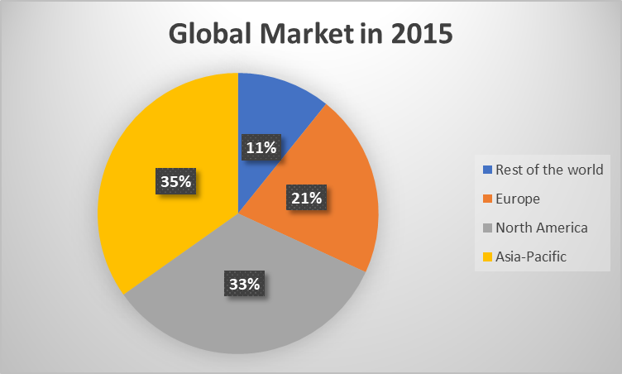
AeroFarms Potential
Current Global Market Share – 17%
Current North America Market Share – 33%,2015 growing to 57%,2020
Meliora
Situation | Recommendation | Analysis | Alternatives | Implementation | Risks | Conclusions

Slide 9
AeroFarms Segment Potential
Meliora
Situation | Recommendation | Analysis | Alternatives | Implementation | Risks | Conclusions

Slide 10
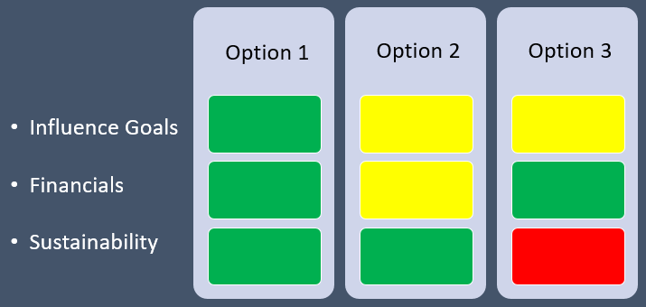
Choosing a Path
Option 1
  Scalability, Energy Efficiency, Beyond Boundaries
Option 2
  Customer Awareness, High Calorie Food, Minimize Capital Requirements
Option 3
  Customer Awareness, Minimize Capital Requirements, Energy Efficiency
Meliora
Situation | Recommendation | Analysis | Alternatives | Implementation | Risks | Conclusions

Slide 11
Timeline
Goals | Phase 1, 1 Year | Phase 2, 1-2 Years | Phase 3, 3-4 Years
Strategic Partnerships | Retailers | Airlines | New Markets
LED Challenge | Energy Suppliers | Transformation | 100% Renewables
Beyond Boundaries | - | Licensing | Licensing Continues
Cost Reductions
Real Estate
Energy
Meliora
Situation | Recommendation | Analysis | Alternatives | Implementation | Risks | Conclusions

Slide 12
Contingency Planning
Risks | Mitigation
Customer Awareness of Organic Food (USA) | Social Media Marketing University Course Integration
Research and Development Costs in Aeroponics* | University R&D Partnerships
Patent Infringement | Licensing Contracts
Meliora
Situation | Recommendation | Analysis | Alternatives | Implementation | Risks | Conclusions

Slide 13
In Conclusion
Revenue
Costs
Profit
International
Strategic Partnerships
Operations and Energy
Increased
Licensing
Meliora
Situation | Recommendation | Analysis | Alternatives | Implementation | Risks | Conclusions

Slide 14
Appendix
Industry Outlook
Buyer - Medium
Supplier - Low
Entrants - Low
Competition - Medium
Substitutes - High
AeroFarms LLC Outlook
Technology / Patents
Substitutions All Present
Partnerships Growing
Cost Controls
Meliora
Situation | Recommendation | Analysis | Alternatives | Implementation | Risks | Conclusions

Slide 15
Appendix
Market Value in 2015 (Million $)
Rest of the world | 110 | 11%
Europe | 215 | 21%
North America | 340 | 33%
Asia-Pacific | 355 | 35%
Total | 1020 | 100%
Prejected Market Value in 2020 (Million $)
North America | 1130 | 57%
Meliora
Situation | Recommendation | Analysis | Alternatives | Implementation | Risks | Conclusions

Slide 16
Appendix
Company | Funding($) | Revenue($) | Type | Competitor % | Efficiency Ratio of Revenue to Funding
AeroFarm | 238,000,000.00 | 50,000,000.00 | Aero | 27% | 21%
Bowery | 117,500,000.00 | 5,000,000.00 | hydro | 3% | 4%
Plenty | 226,000,000.00 | 5,000,000.00 | hydro | 3% | 2%
Gotham Greens | 42,900,000.00 | 105,000,000.00 | hydro | 57% | 245%
BrightFarm | 113,900,000.00 | 11,500,000.00 | hydro | 6% | 10%
Lufa | 5,000,000.00 | 7,000,000.00 | Aqua | 4% | 140%
Total | 743,300,000.00 | 183,500,000.00 |  | 100% | 25%
Meliora
Situation | Recommendation | Analysis | Alternatives | Implementation | Risks | Conclusions

Slide 17
Appendix
Market size | Total($)
2026 | 12,770,000,000.00
2023 | 6,400,000,000.00
2020 | 1,970,000,000.00
2016 | 1,500,000,000.00
Meliora
Situation | Recommendation | Analysis | Alternatives | Implementation | Risks | Conclusions

Slide 18
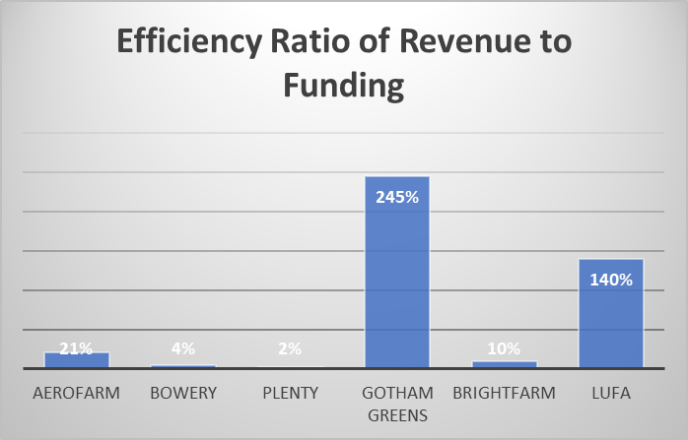
Appendix
Meliora
Situation | Recommendation | Analysis | Alternatives | Implementation | Risks | Conclusions

Slide 19
Influence Goals
Financials
Sustainability
Option 1
Option 2
Option 3
Meliora
Situation | Recommendation | Analysis | Alternatives | Implementation | Risks | Conclusions

